Slide 1
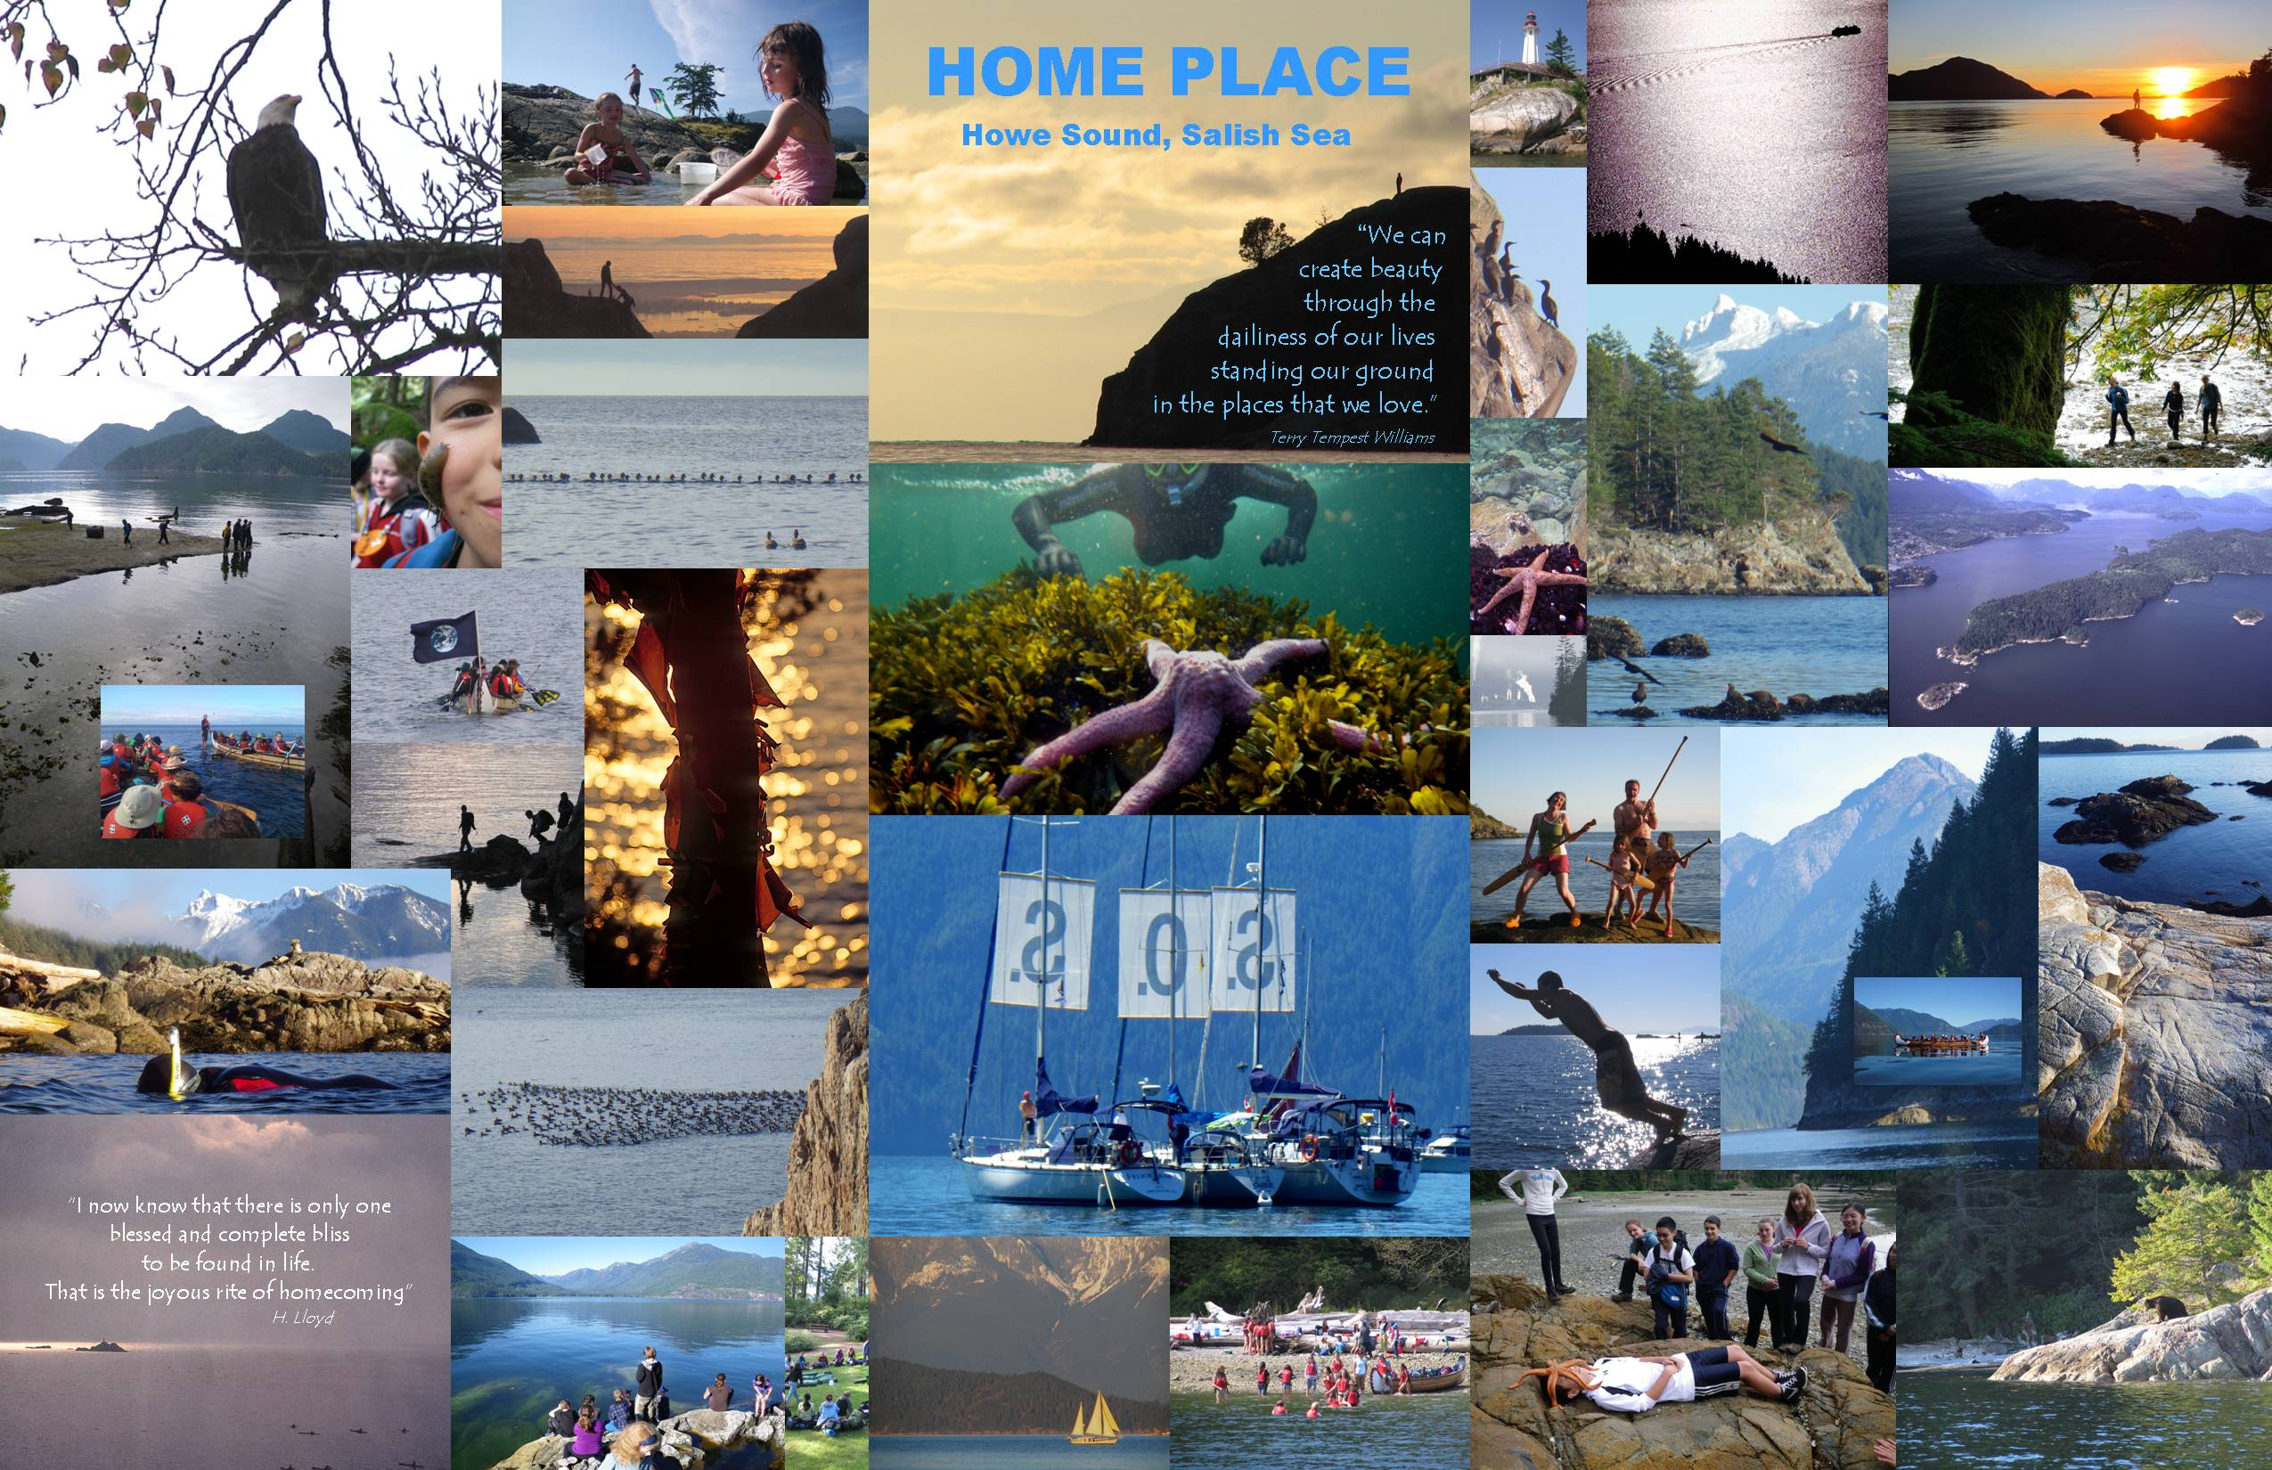
Collage by Tim Turner

Slide 8
Questions for today:
Do you support meeting with Parks Canada, to present our concept for a new Near-Urban National Park, to be centered on Gambier Island?
If so, do you support the call for Parks Canada to commit to a feasibility study and public consultation, to consider what that park might be?

