Slide 1

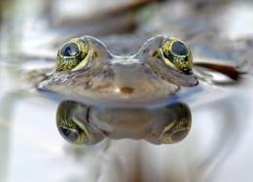
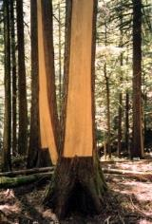
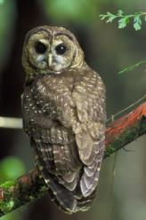
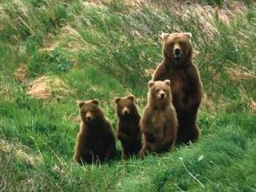
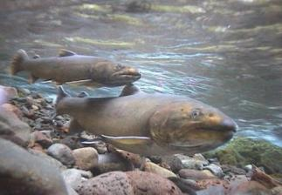
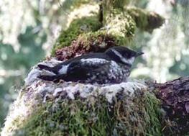
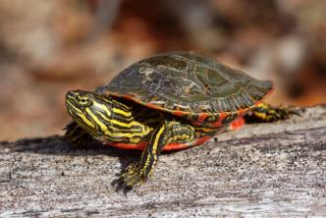
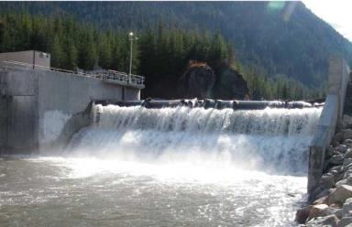
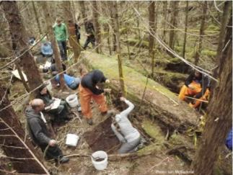
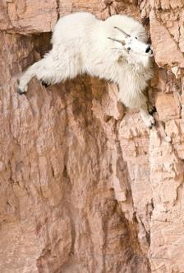
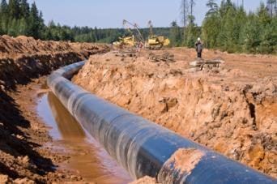
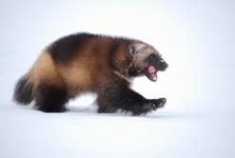
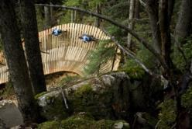
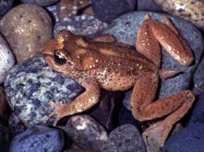
‘Stewardship Baseline’ Objectives Tool
A Demo
Notes:
Slide 1
I’m Scott Barrett, the Director of Resource Management in FLNRO for the South Coast. I’ve been asked to introduce you to a web-map tool that may have utility for a number of natural resource management initiatives and decisions across the sector.

Slide 2

‘Management’ of Natural Resources
Set Objectives
Legal objectives & policy
Land-use plans
Management Objectives
Inventory
Cumulative Effects
Compliance
Effectiveness Assessments
Statutory decisions
Authorizations/permits etc.
Government actions
Partnership actions
SBOT
Dashboard
Assess
Manage
Notes:
Slide 2
One way to define the business of natural resource management is as a continuous improvement cycle.
We implicitly or explicitly set objectives for different economic, social and environmental values through regulations and policy, land-use plans, and operational management objectives.
We assess how well we’re meeting those objectives through inventory and monitoring initiatives, and
Government, industry and other partners take actions to directly manage those values.
The SBOT tool is being designed to communicate the objectives and assessment outputs in order to provide information to government, industry and other stakeholders in the management of the resources.
Today’s demo is using screenshots of the tool so you can see the layout and I’ll get into some examples of how we’re starting to apply it.
While I’m demonstrating static screenshots of the tool, I’d like you to keep in mind that the user is able to interact with all of the elements in the dashboard, zoom-in, zoom-out, change layers etc.

Slide 3
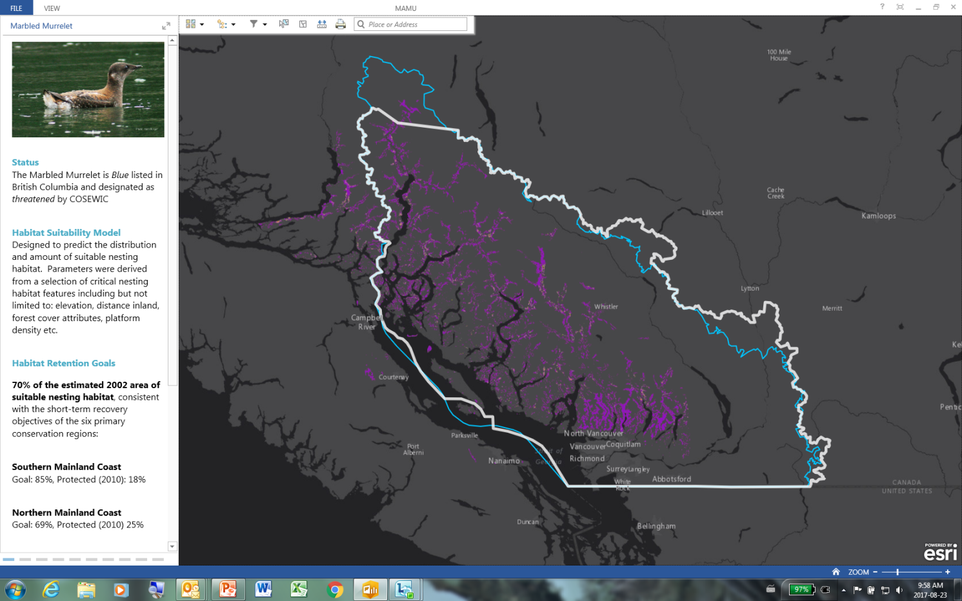
MAMU Intro Panel
Notes:
Slide 3
I’m starting with the dashboard for the Marbled Murrelet. As you may know, murrelets are small seabirds that nest in coastal old growth forests in BC.
For each value that we develop a dashboard for, we include an introductory panel describing the value, the specific objectives for that value and the source of those objectives; whether they be scientific advice to government, legal objectives or other.
In some cases we may have multiple objectives for a single value and we are careful to be transparent about where the different objectives have originated and their respective limitations.
As you can see in the bottom left of the slide, the species recovery strategy recommends that government retain 85% of the region’s 2002 suitable nesting habitat for murrelets over a 30 year timeframe.

Slide 4
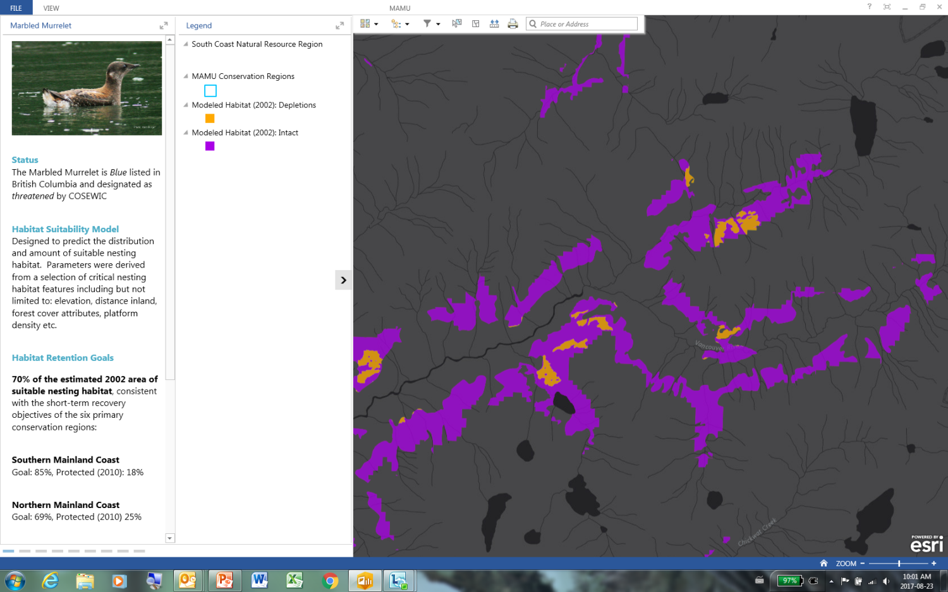
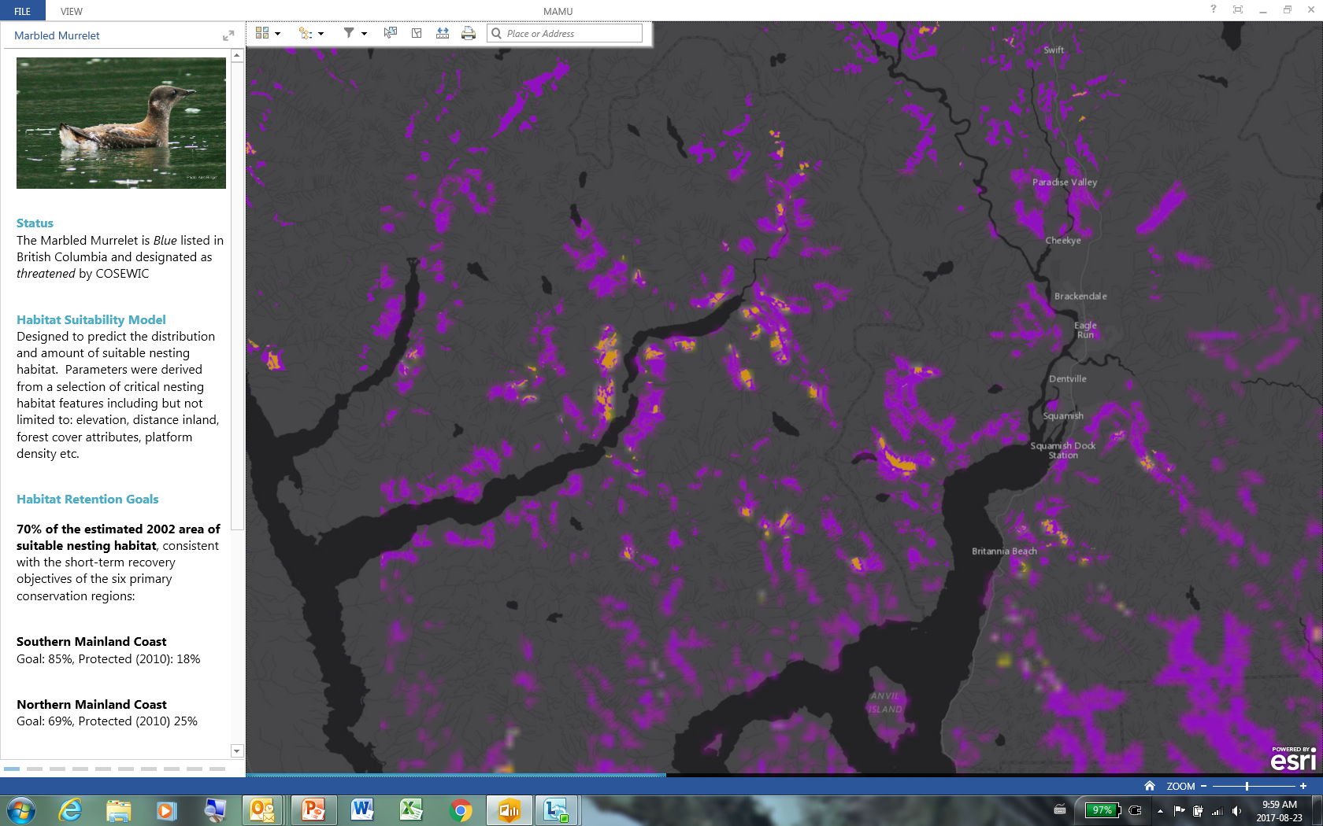
MAMU Habitat and Depletion
Notes:
Slide 4
The tool maps out all of the 2002 suitable habitat in purple and where that habitat has been harvested since 2002 is represented in orange.

Slide 5
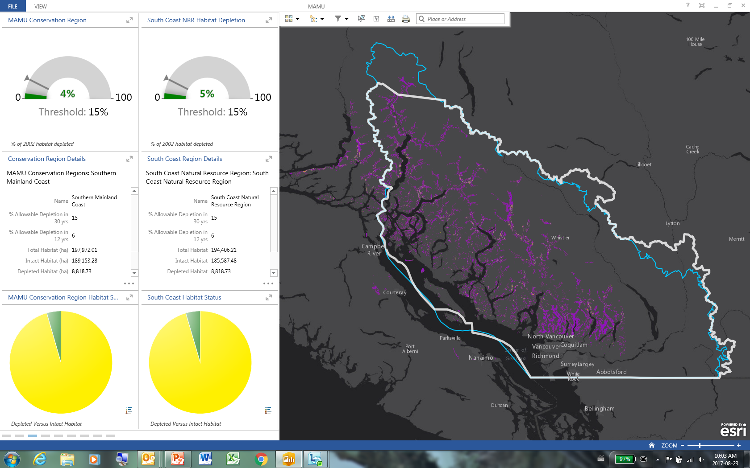
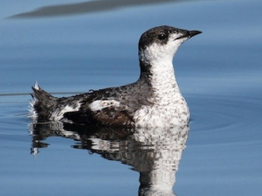
MAMU – Conservation Region Gauge
Notes:
Slide 5
We then toggle through the panels to uncover dashboard outputs that both reveal the target, in this case the 15% depletion threshold is shown in the upper left panel with the bar with the arrow, the current depletion for the region is the filled area of the dial and how well we’re meeting this objective is represented by the colour; in this case it’s green – and green is good..

Slide 6
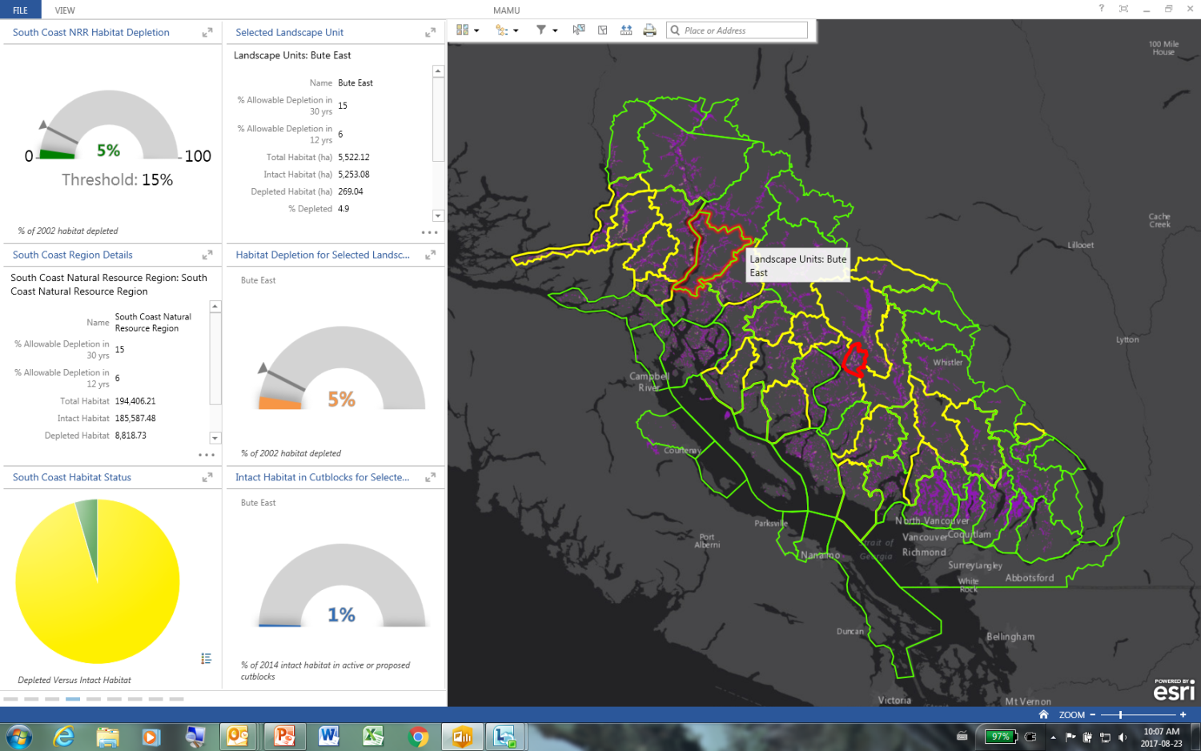
MAMU Landscape Unit Status
Notes:
Slide 6
For the murrelet, we have also chosen to report the habitat objective at the Landscape Unit level, a more meaningful scale for our decision makers. While the map summarizes the status of each unit by the colour coding (green yellow red), the user can also select each unit and get more details; including the impact of proposed cutblocks as shown here in the bottom right dial; which suggests currently proposed cutblocks in this Landscape Unit would impact 1% of the murrelet habitat in the unit.

Slide 7
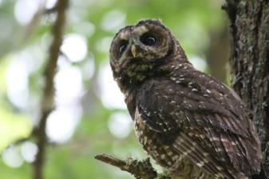
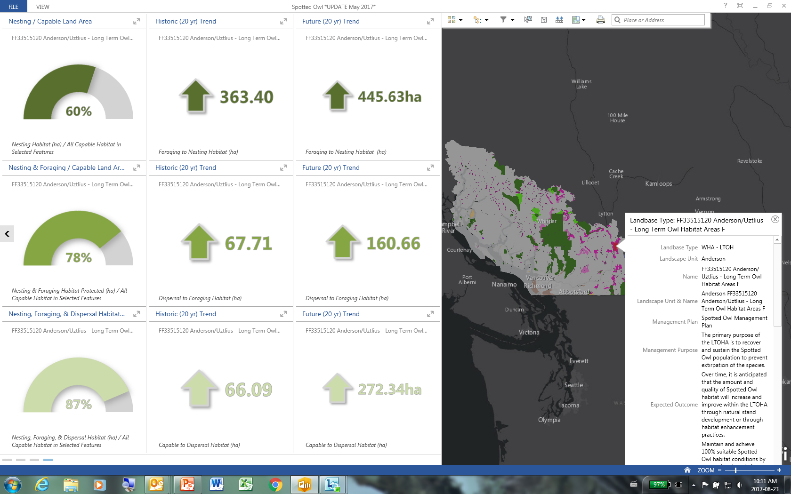
SPOW - Trends
Notes:
Slide 7
This is a snap-shot of the Spotted Owl dashboard. I’ve chosen this slide to demonstrate how, for a forest-dependant species, we are able to summarize historic and future trends based upon past and future forest growth for a particular spatial unit. In this case we see with the top two dials, that the owl nesting habitat has been increasing over the past 20 years (by 363 Ha) and will continue to increase over the next 20 years (by 445Ha) in this wildlife habitat area.

Slide 8
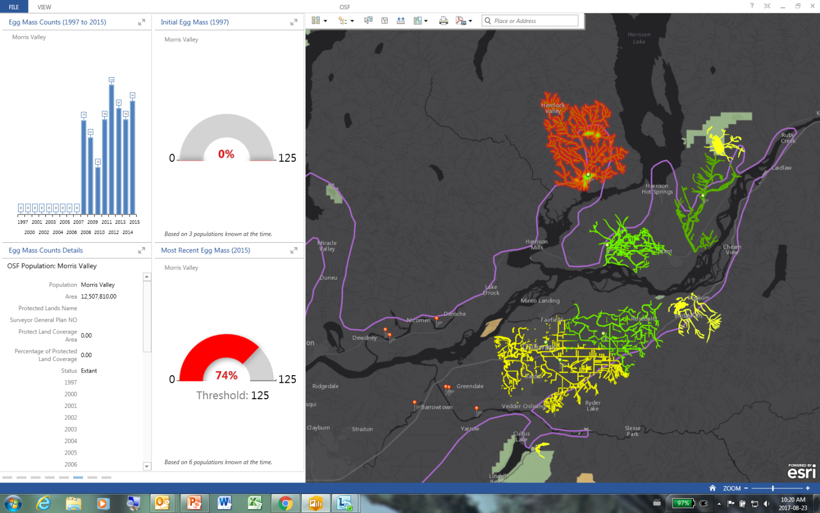
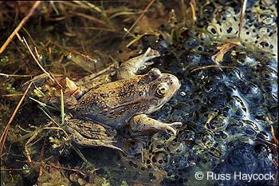
OSF – population summary
Notes:
Slide 8
This dashboard is for an extremely endangered amphibian, the Oregon Spotted Frog, located in the eastern Fraser Valley. I have chosen this screenshot to demonstrate that we are able to input wildlife population data. The federal recovery strategy prescribes specific population targets and the tool allows us to summarize and communicate how well we’re meeting them. As you can see, for a given population that is represented as a network of streams on the map, the target is to have 125 egg masses produced annually. In this case the egg mass count in 2015 was 93; and the bar graph in the upper left summarizes all of the annual egg mass counts over time.

Slide 9
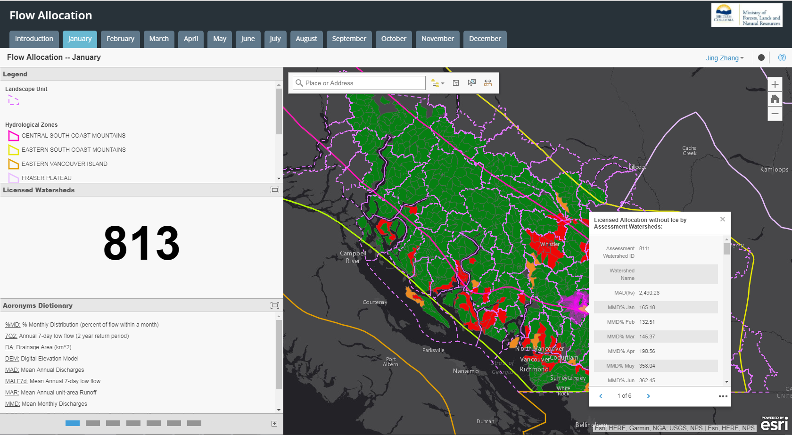
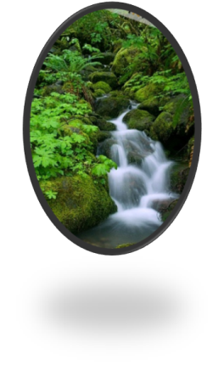
Flow Allocation - January
Notes:
Slide 9
To demonstrate the breadth of values we’re working on, I’ve also included a couple of screenshots of the flow allocation dashboard. In the box appearing on the map itself, we present a number of key watershed-scale hydrometrics such as mean annual discharge, the seven-day low-flow, mean monthly discharge etc for each watershed. (These data are based on a model that has been calibrated with actual local stream flow data.) For each watershed represented, staff also assess the volume of water licensed for extraction from these streams and then developed a risk-rating for determining the risk of not having enough water for new licenses, downstream users or environmental flow needs. Red is high risk, yellow moderate and green is low risk. Note that these risk ratings are being represented by month; so this is the risk-rating for January. As I click over to September…

Slide 10
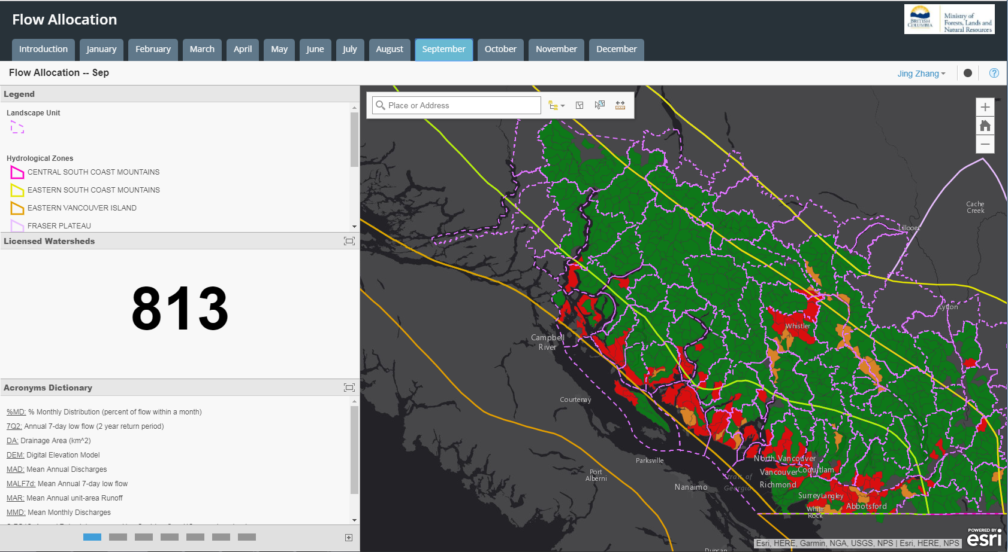
Flow Allocation - September
Notes:
Slide 10
a new colour scheme for these same watersheds appears. (You can toggle back and forth between these slides to notice the changes in each watershed between months.)

Slide 11
Applications of SBOT
Operational Decisions
  Environmental assessments
  Tenure
  Permit
Tactical Initiative
  Monitoring
  Integrated investment planning
Strategic
  Forest, land or water resource use
    Planning and
    Objective setting
Notes:
Slide 11
In order to walk you through the utility of this tool, we have considered it’s potential application in three separate categories: Operational, Tactical and Strategic decisions or initiatives. For the purpose of this demo, operational are things like environmental assessments and statutory decisions; tactical includes monitoring activities and integrated investment planning; and strategic refers to things like forest, land and water use planning.

Slide 12
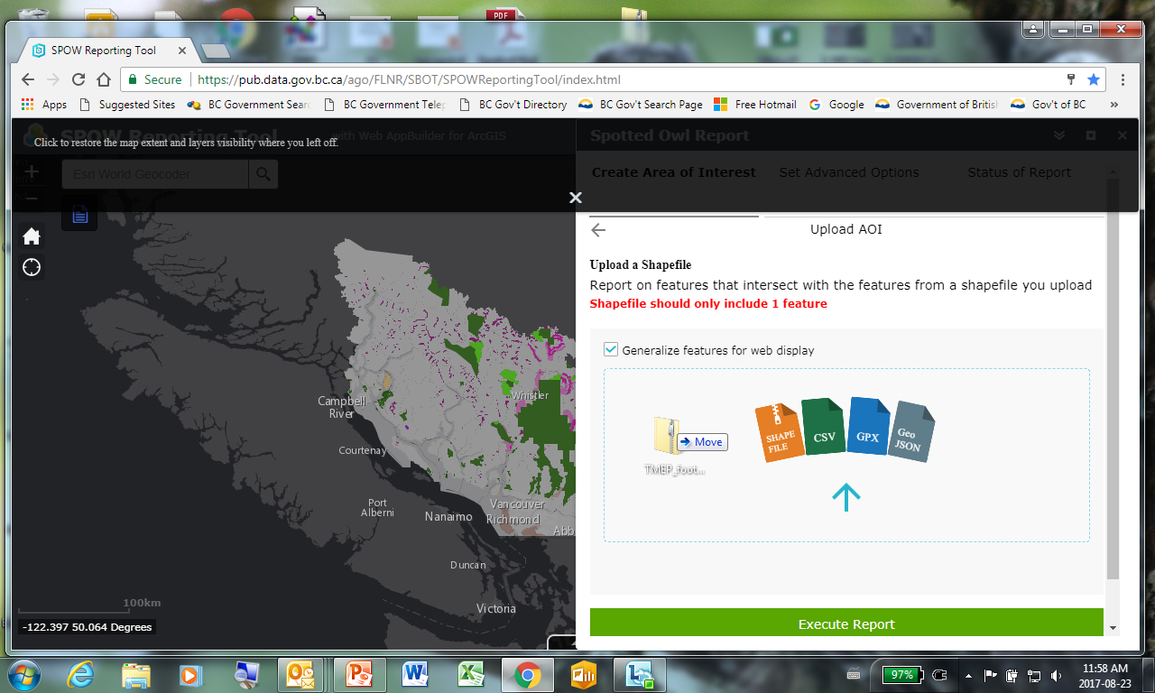
Kinder Morgan Pipeline
Notes:
Slide 12
We have started to use the tool to support operational decisions. One example is the production of information to support decisions around the Transmountain Pipeline expansion project (ie. Kinder Morgan). In order to conduct an environmental assessment against a given value, the user can upload a shapefile into the reporting component of the dashboard. In this case we literally dragged and dropped a proposed pipeline shapefile from a consultant’s email. The tool instantly uploads the shapefile information and maps it accordingly. This is shown on the following slide…

Slide 13
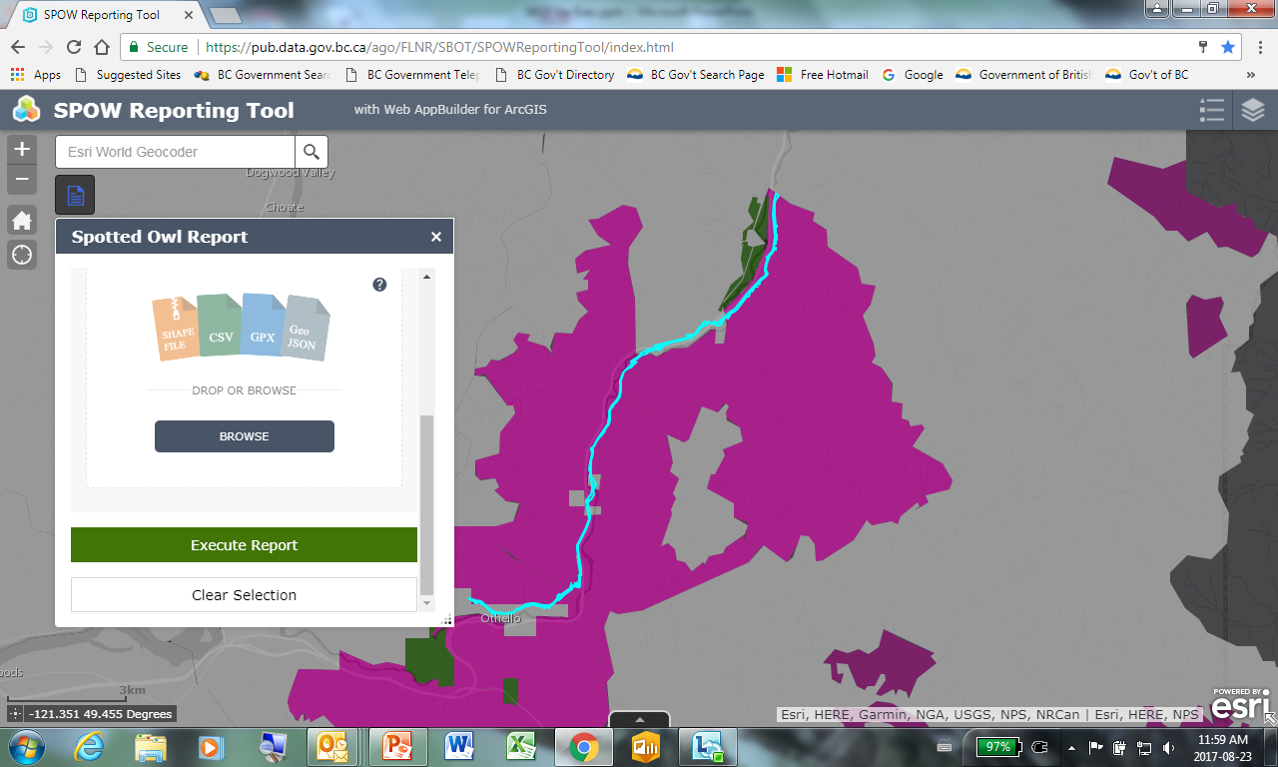
Notes:
Slide 13
This element of the tool allows us to prescribe some key calculations, summaries and a report format, that will produce a pdf report giving a user a set of information about the imported shapefile as it relates to the dashboard value. After importing the shapefile, the user then simply presses ‘execute report’ and the pdf report is produced.

Slide 14
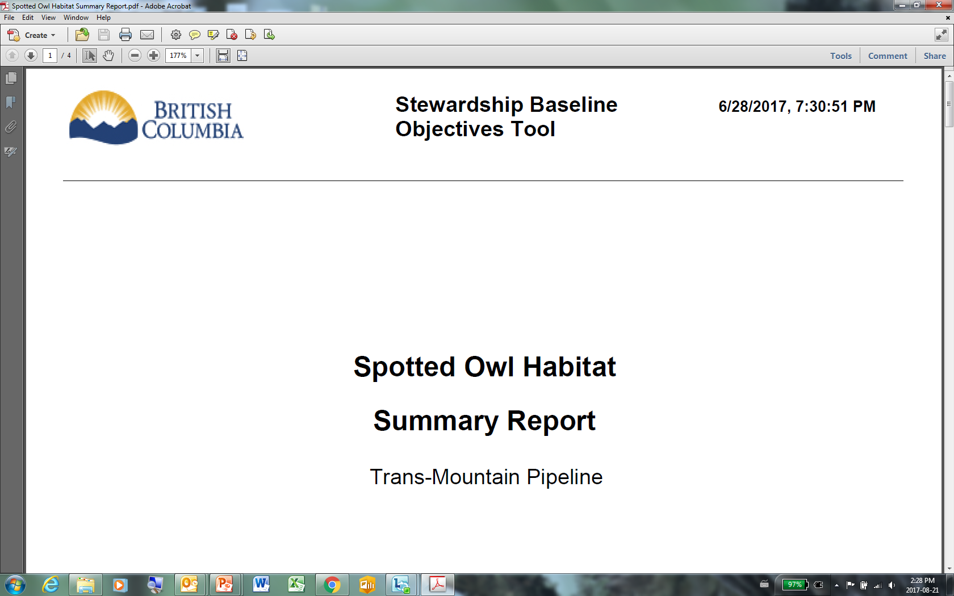
Kinder Morgan Pipeline
Notes:
Slide 14
And this pdf shows up on the user’s screen…

Slide 15
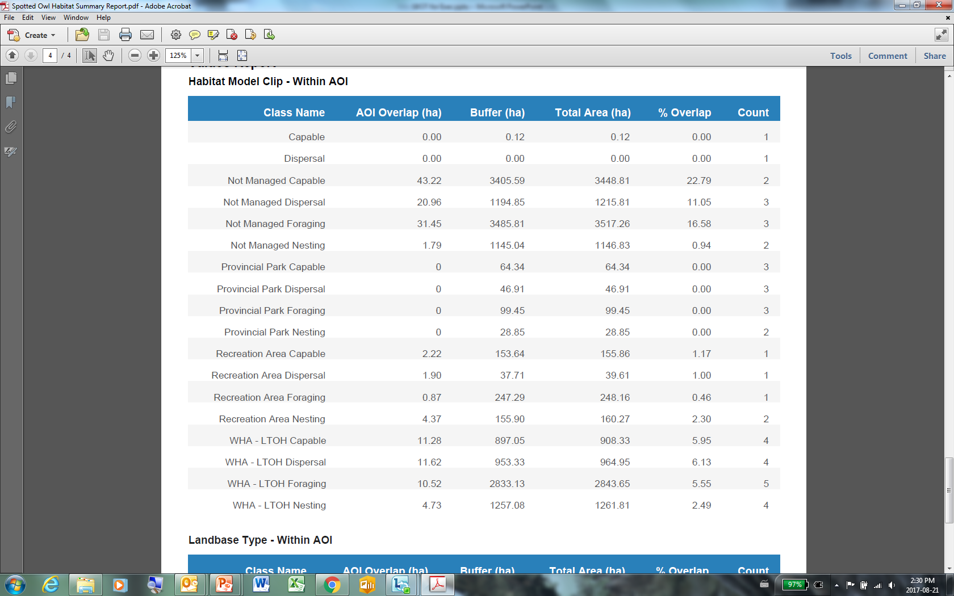
Kinder Morgan Pipeline
Notes:
Slide 15
The subject report can contain whatever information we think should be considered in a given decision. In this case, this information has been used by the ministry and the proponent’s agents to develop a mitigation plan for the project. The generation of this report likely saved the project thousands of dollars and weeks of time.

Slide 16
Operational – Environmental Assessment
Notes:
Slide 16
This table is an analysis developed through the tool that summarizes the impacts of the pipeline against a habitat quality and quantity index for spotted owls at various scales, including historic and future trends. This unique type of summary, that gives a decision maker some important context to support their decision, is produced relatively easily using this tool and will be included in the pdf report produced.

Slide 17
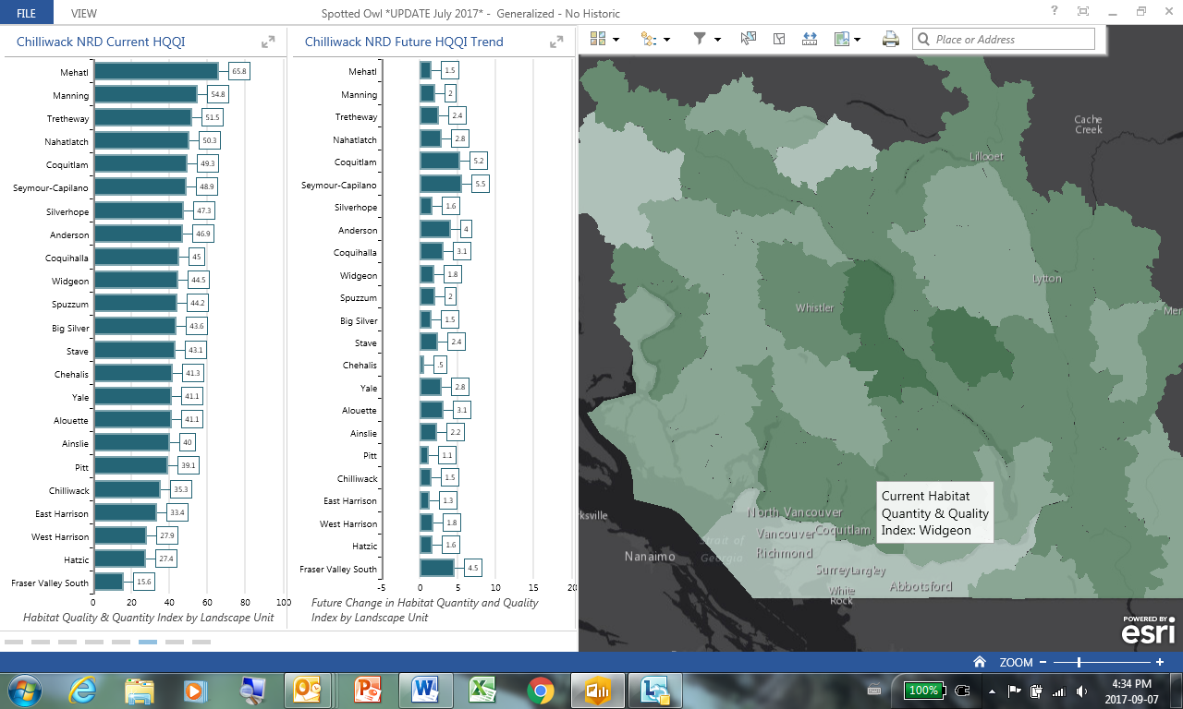
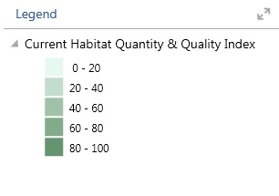
Spotted Owl – Mitigation Opportunities
Notes:
Slide 17
We can also use the tool to start identifying where we want a proponent to invest mitigation efforts. This is an output in the tool summarizing spotted owl habitat quality and quantity index by landscape unit. The far left graph represents the current status of each unit (not all of the units are shown here); the graph to the right of it are the predicted changes to the index over the next twenty years (almost all of them are positive). Essentially the objective for the owl is to make the colours darker on the map. This information could be used to let a proponent know where best to do some habitat enhancement work.

Slide 18
How Aquatic Assessments Inform One Another
“Watershed
Conditions”
Riparian
Area
Disturbance
Road Density
on unstable
slopes
Climate
River
Forecast
Road
Density
Near Streams
Road
Density
Stream
Crossing
Density
Riparian
Condition
RAR
Assessment
Water Quality
Chemistry
FREP
Riparian
Assessment
Multi-sonde
Network
Temperature
FREP
Water Quality
Assessment
Surface Hydrology
Peak Flows
Instream Flow
Monitoring
Channel
Condition
Water
Use
Summer
Low-flows
ISW
Licensed
Use
Angling
Fish & Aquatic
Wildlife
Populations
Angling Effort
Groundwater
Fish Inventory
Marine
Survival
(Anad. fish)
Groundwater
Monitoring
Aquatic
Wildlife
Inventory
Notes:
Slide 18
We are starting to explore the use of the tool to support a couple of tactical initiatives in the region. First of all, it looks to be a good portal to support the integration of monitoring & assessment initiatives. The orange ovals here represent aquatic or watershed-based data collected across the sector and the other coloured ovals are the values that government manages within watersheds. Figuring out how to integrate these data sources to inform one another is ofcourse no easy task.

Slide 19
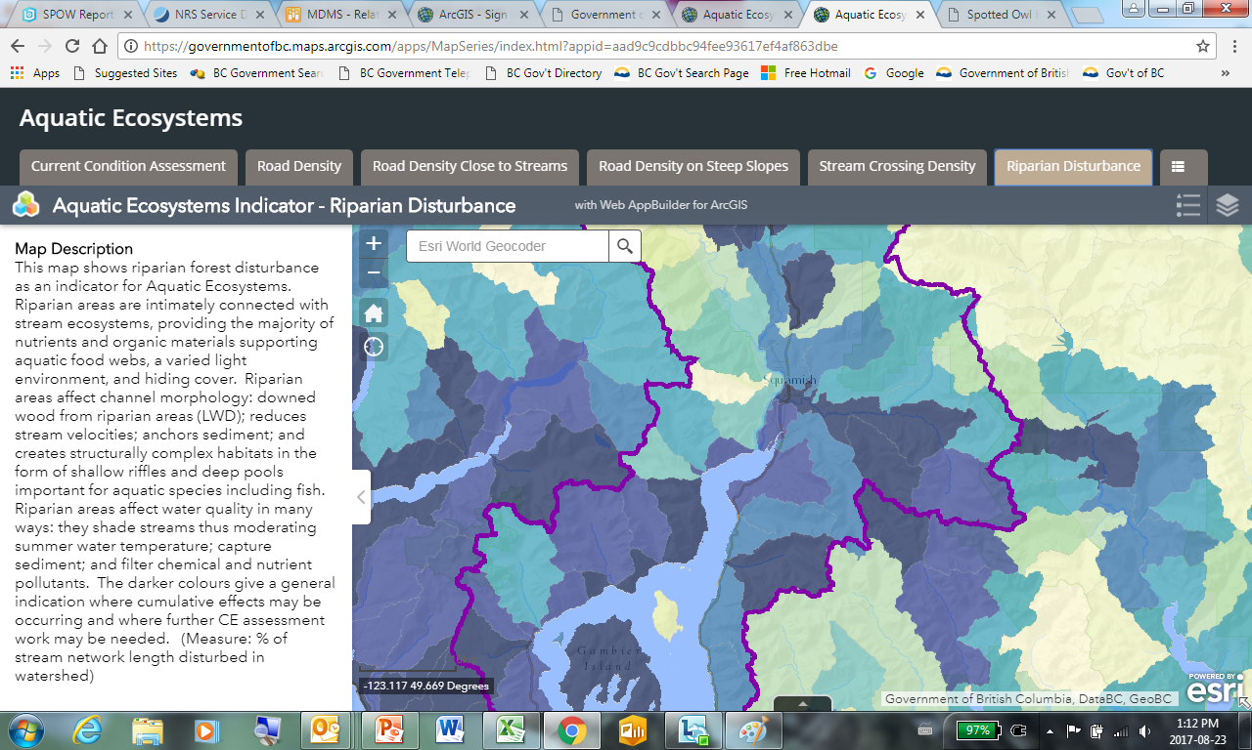
FREP Riparian & Channel
Stream-flow Monitoring
Water Quality
Fish Inventory
Notes:
Slide 19
As we develop the tool, we will be able to include more of these monitoring data or live-links to these data in our region so they are co-located onto a single web-map. For instance: these maps are individual and combined outputs for the cumulative effects assessment of aquatic ecosystems or watershed conditions. As you may be aware, the assessment protocol includes indicators like road density, riparian disturbance and peak flow index. Essentially the darker colours represent watersheds predicted to be at higher risk of having poor aquatic ecosystem conditions. We are working with this tool to integrate other monitoring data such as FREP results on riparian and channel conditions, hydrometrics, water quality and fish inventories. The user can then start integrating the information from these different sources to take a strategic and transparent approach to re-evaluating actual risks, fill knowledge gaps over time and inform potential management responses.

Slide 20
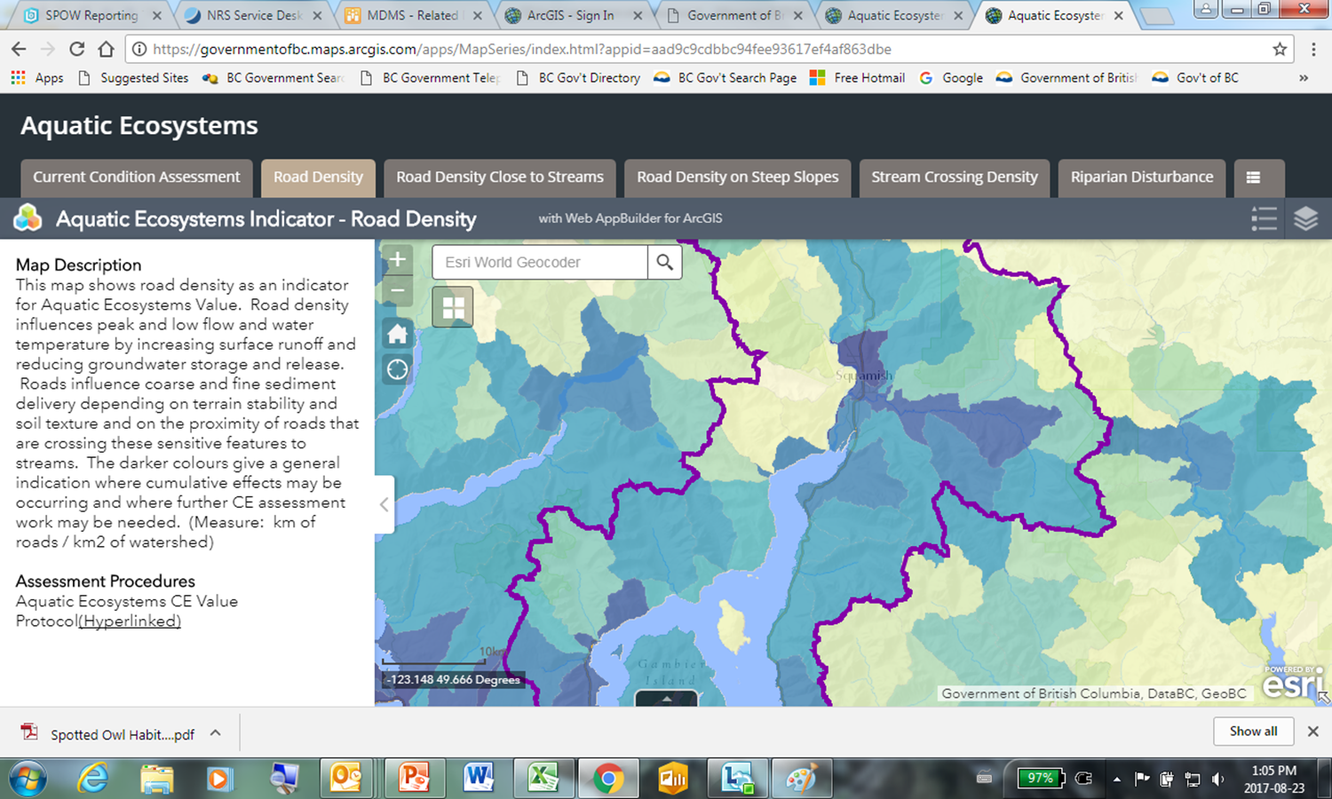
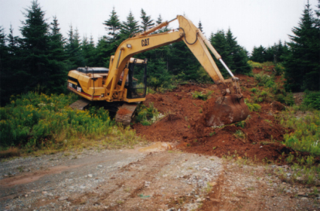
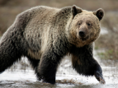
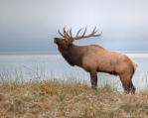
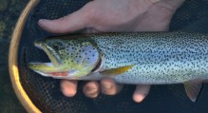
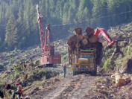
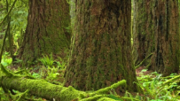
Tactical – Integrating Investments
It will result in:
Grizzly Bear
habitat
Elk habitat
Aquatic
Ecosystem
Timber
Supply
Carbon
Sequestering
Road deactivation here
Notes:
Slide 20
We also believe the tool forms the foundation for integrating and planning investments. A user will be able to pull together objectives and assessments for a variety of values like wildlife, forest carbon and timber supply in order to optimize the location of activities like silviculture practices, reforestation and road deactivation and then maximize benefits for multiple values. For example, we’ll eventually be able to immediately calculate the specific benefits of a specific road deactivation for environmental values considered impacted by roads for a specific area, such as grizzly bears, elk and aquatic ecosystems and integrate that information with anticipated effects on timber supply and carbon sequestration so we can predict where can get our biggest bang for the buck.

Slide 21
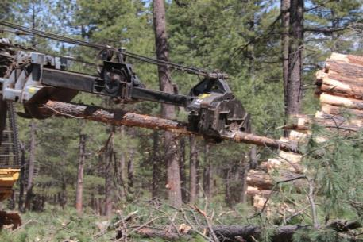
Tactical – Integrating Investments
It will result in:
Grizzly Bear
habitat
Elk habitat
Aquatic
Ecosystem
Timber
Supply
Carbon
Sequestering
Stand enhancement here
Notes:
Slide 21
Or we could efficiently evaluate the benefits of stand-thinning for a number of different values and prioritize the best locations to invest in this activity.

Slide 22
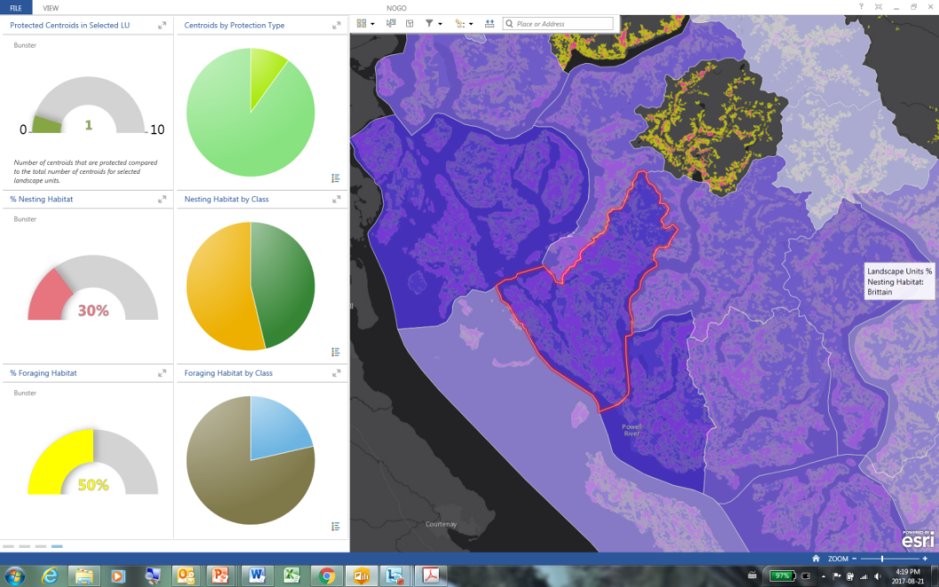
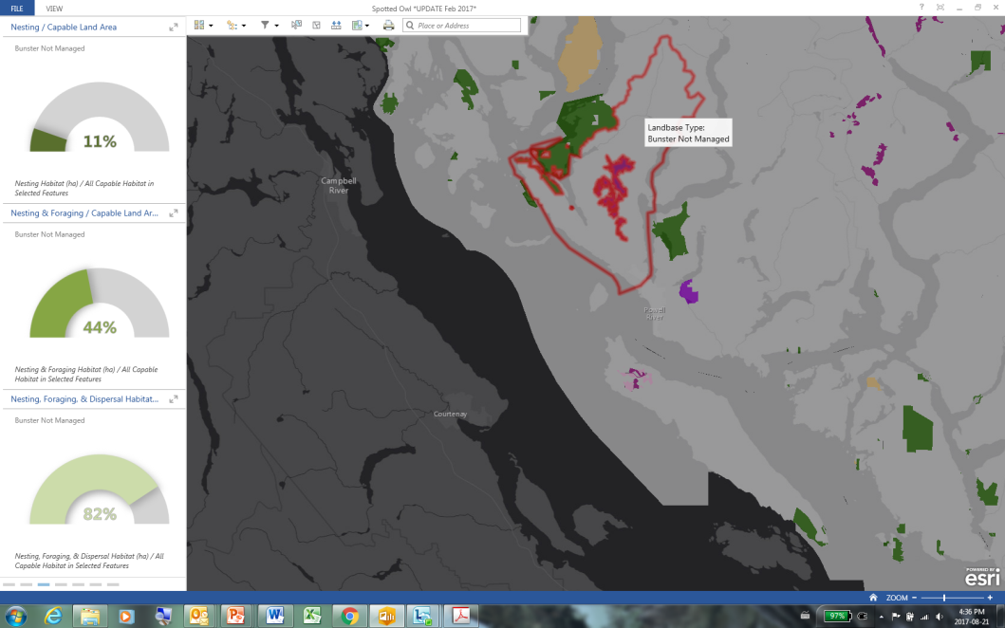
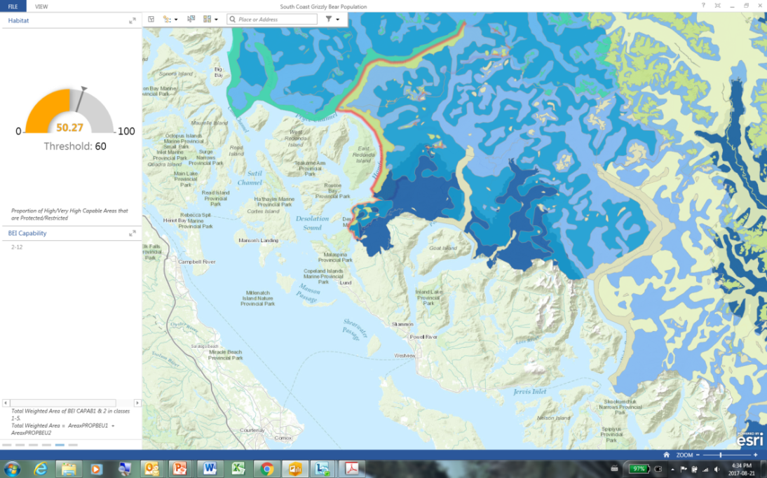
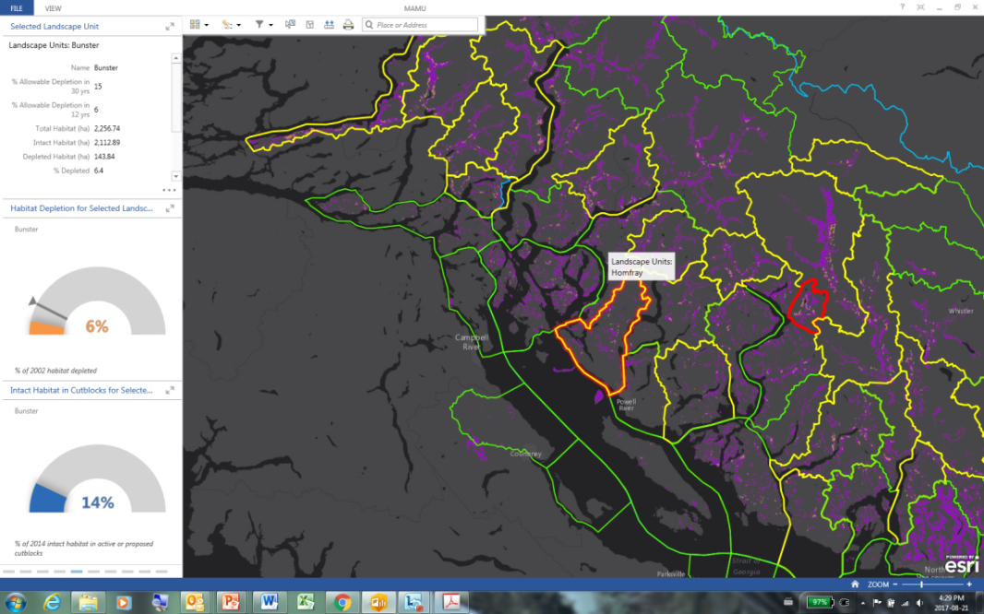


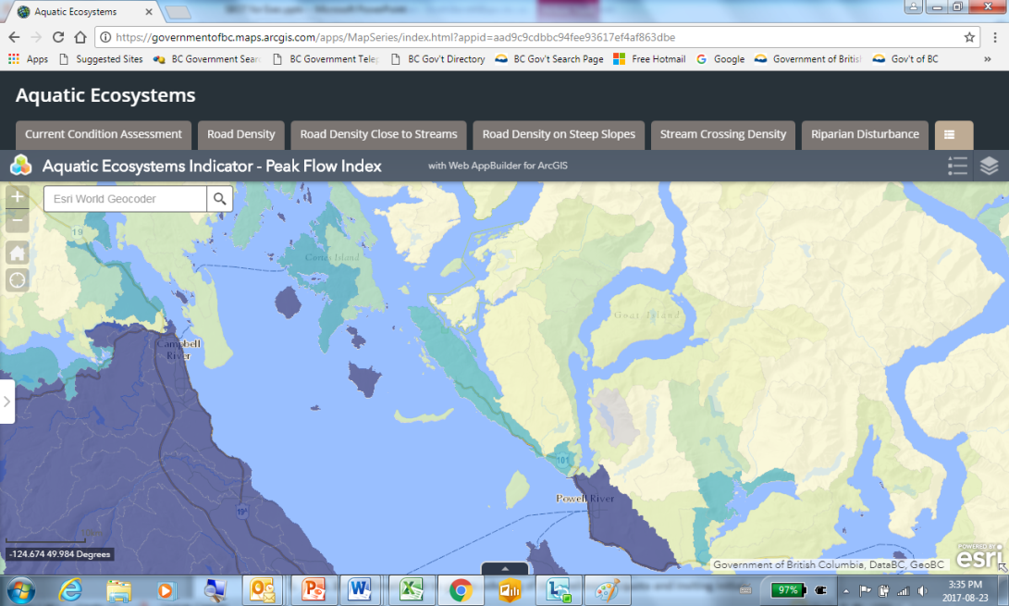

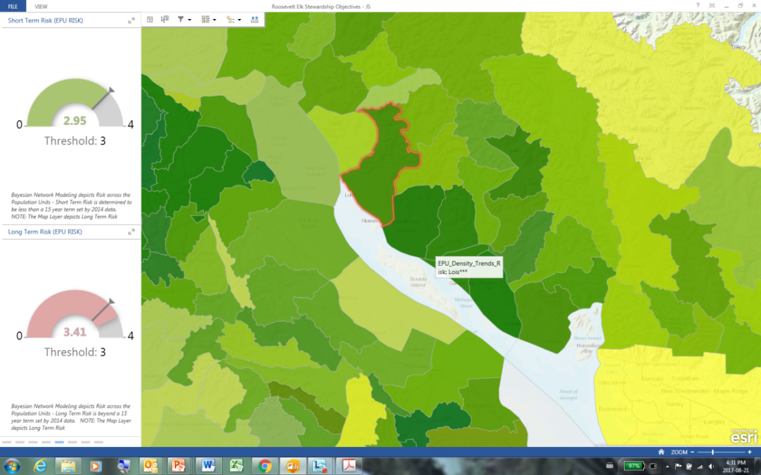
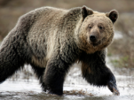
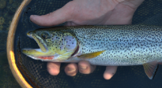

Notes:
Slide 22
Finally, we are just beginning to explore the use of the tool in some strategic initiatives. The user will be able to run different scenarios and instantly get outputs for a variety of values in a single area. We can then manipulate the inputs to investigate an optimized approach to manage for all of these values, to overlap any constraints as much as possible and find the best balance between competing objectives. Bottom line: the tool offers instantaneous feedback from a number of different resource use and impact scenarios at multiple scales. We think this presents a potential opportunity to really clarify the what we want in terms of forest, land & water objectives while fully considering a number of values at once.

Slide 23
What We’ve Learned
Showing people on an inter-active map:
  what we’re trying to achieve and
  how well we’re achieving it is extremely powerful
The Howe Sound CE work has driven us to be innovative in:
  How we communicate our assessments and
  How we manage cumulative effects (in Howe Sound and beyond)
Notes:
Slide 25
The tool looks to have genuine potential to support a number of emergent and current initiatives such as:
Environmental mitigation,
Cumulative effects assessment, reporting and stakeholder engagement,
Integrated monitoring & assessment, and
Integrated investment planning.
The region is keen to explore opportunities to partner with other branches, areas/regions to improve and accelerate the development of the tool.
If you or your staff are interested in seeing a ‘live’

Slide 24
Next Steps
This fiscal
  Build SBOT:
    Finalizing development of dashboards ~9 values
  Apply SBOT:
    Using reports for major projects
    Inform inventory & monitoring efforts
    Exploring use in strategic planning initiatives
Next fiscal
  Develop dashboards for additional 6-8 values
  Train regional decision-makers to explore the incorporation of tool into review & approval processes
  Apply SBOT to integrated investment planning
Long term
  Develop & maintain dashboards for 25-30 values in the region
  NRS-wide access to a multi-value dashboard/assessment/reporting tool
Notes:
Slide 24
Our next steps this fiscal are to continue to build the tool focused on finalizing development of dashboards for approximately 9 values and continue to apply the tool in the review of major projects, to inform inventory & monitoring efforts and exploring it’s use in strategic planning initiatives.
Next year we plan to continue to develop dashboards for an additional 6-8 values, begin training of regional decision-makers to use in review & approval processes and use the tool in the development of an integrated investment plan.
Longer term we will develop & maintain dashboards for 25-30 values in the region and explore opportunities to provide even wider access to the tool.

Slide 25
Questions?
South Coast SBOT Delivery Schedule
 | March-2018 | March-2019 | March-2020 | March-2021 | March-2022
Dashboards | Rosevelt Elk | Black-tailed Deer | Pacific Giant Salamander | Pacific Water Shrew
 | Spotted Owl | Mountain Goat | Western Screech Owl | Conservation Lands
 | Grizzly Bear | Sturgeon | Wolverine | Lakes (Fisheries)
 | Oregon Spotted Frog | Northern Goshawk | Coastal Tailed Frog | Rivers (Fisheries)
 | Western Painted Turtle | Marbled Murrelet | Phantom Orchid | Foreshore habitats
 | Biodiversity | Old Growth
 | Environmental Flow
 | Tall Bugbane
 | Watershed Condition
Assessment Tool | Spotted Owl | Grizzly Bear (CEF) | Western Painted Turtle | Western Screech Owl | Conservation Lands
 | Northern Goshawk | Oregon Spotted Frog | Pacific Giant Salamander | Wolverine | Lakes (Fisheries)
 | Marbled Murrelet | Watershed Condition | Sturgeon | Tall Bugbane | Rivers (Fisheries)
 | Environmental Flow | Rosevelt Elk | Coastal Tailed Frog | Phantom Orchid | Foreshore habitats
 | Biodiversity | Mountain Goat |  | Pacific Water Shrew
 |  | Black-tailed Deer
 |  | Old Growth
Report Tool | Spotted Owl | Old Growth | Oregon Spotted Frog | Western Screech Owl | Conservation Lands
 | Environmental Flow | Rosevelt Elk | Watershed Condition | Wolverine | Lakes (Fisheries)
 |  | Grizzly Bear (CEF) | Pacific Giant Salamander | Coastal Tailed Frog | Rivers (Fisheries)
 |  | Mountain Goats | Sturgeon | Tall Bugbane | Foreshore habitats
 |  | Black-tailed Deer | Northern Goshawk | Phantom Orchid
 |  |  | Marbled Murrelet | Wolverine
 |  |  | Western Painted Turtle | Pacific Water Shrew
Data Layers | Constraints/Protected | Disturbance
Notes:
Slide 26
If you or your staff are interested in seeing a ‘live’ demonstration of the tool, our staff would be happy to oblige.
If we have time, I’d be happy to field any questions you may have.

