Slide 1
What might a Biosphere
look like for Howe Sound?
Its boundaries?
Its zones?

Slide 2
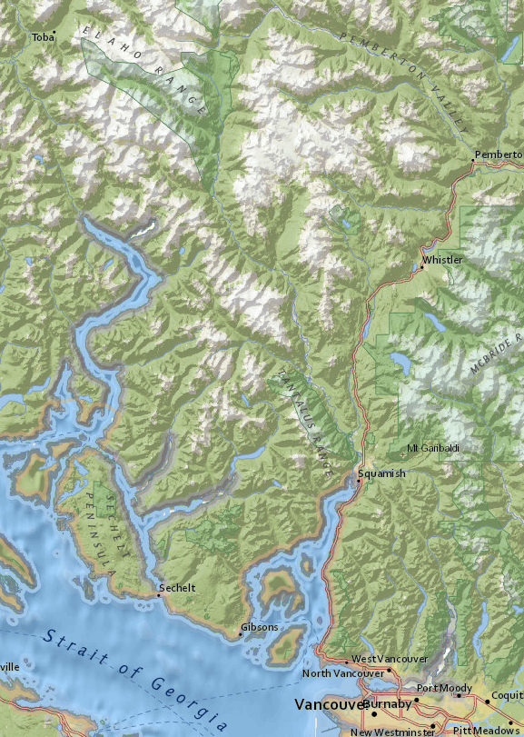
Howe Sound
Region
Whistler
0 20 km
Squamish
Gibsons
West Vancouver

Slide 3
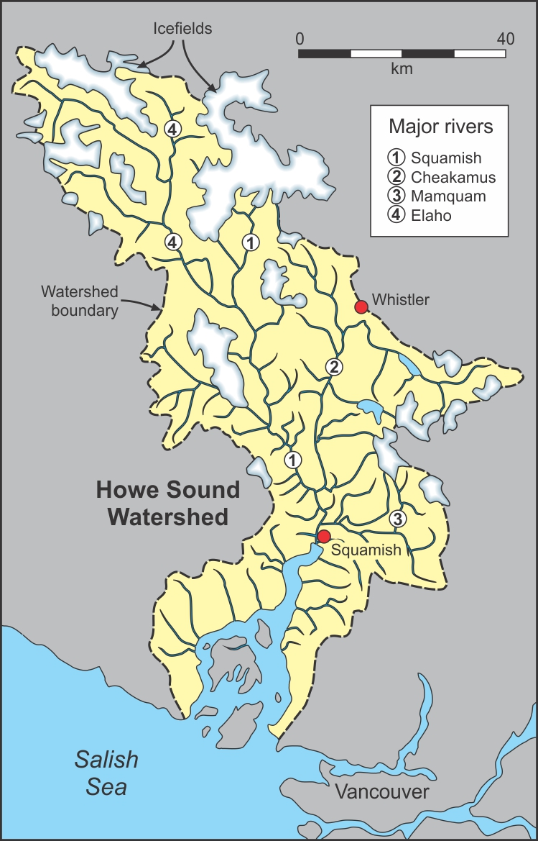
Howe Sound
Region
Whistler
Whistler
0 20 km
Squamish
Squamish
West Vancouver
Gibsons
West Vancouver
Gibsons
Howe Sound
Watershed

Slide 4
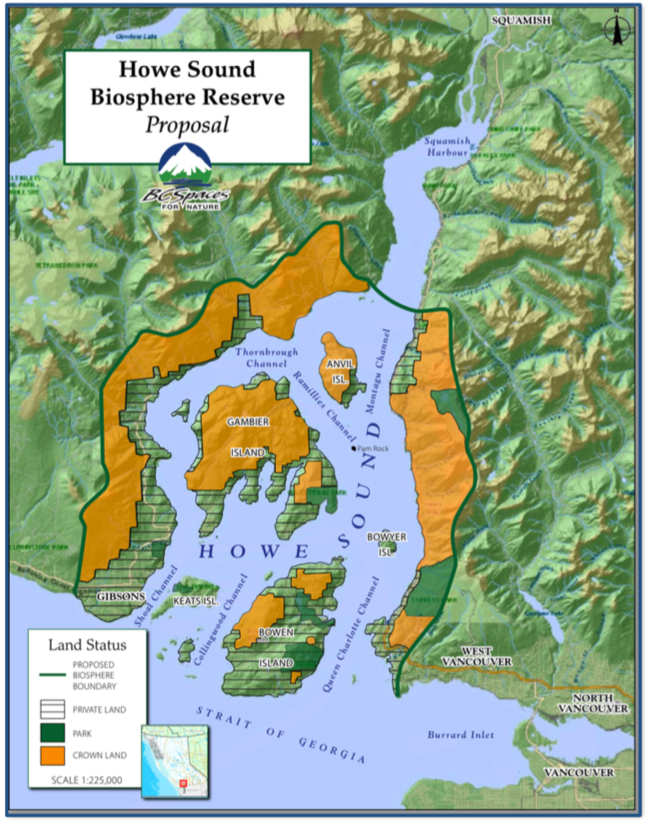
BC Spaces for Nature
Original Biosphere Concept
Whistler
Squamish
Gibsons
West Vancouver

Slide 5
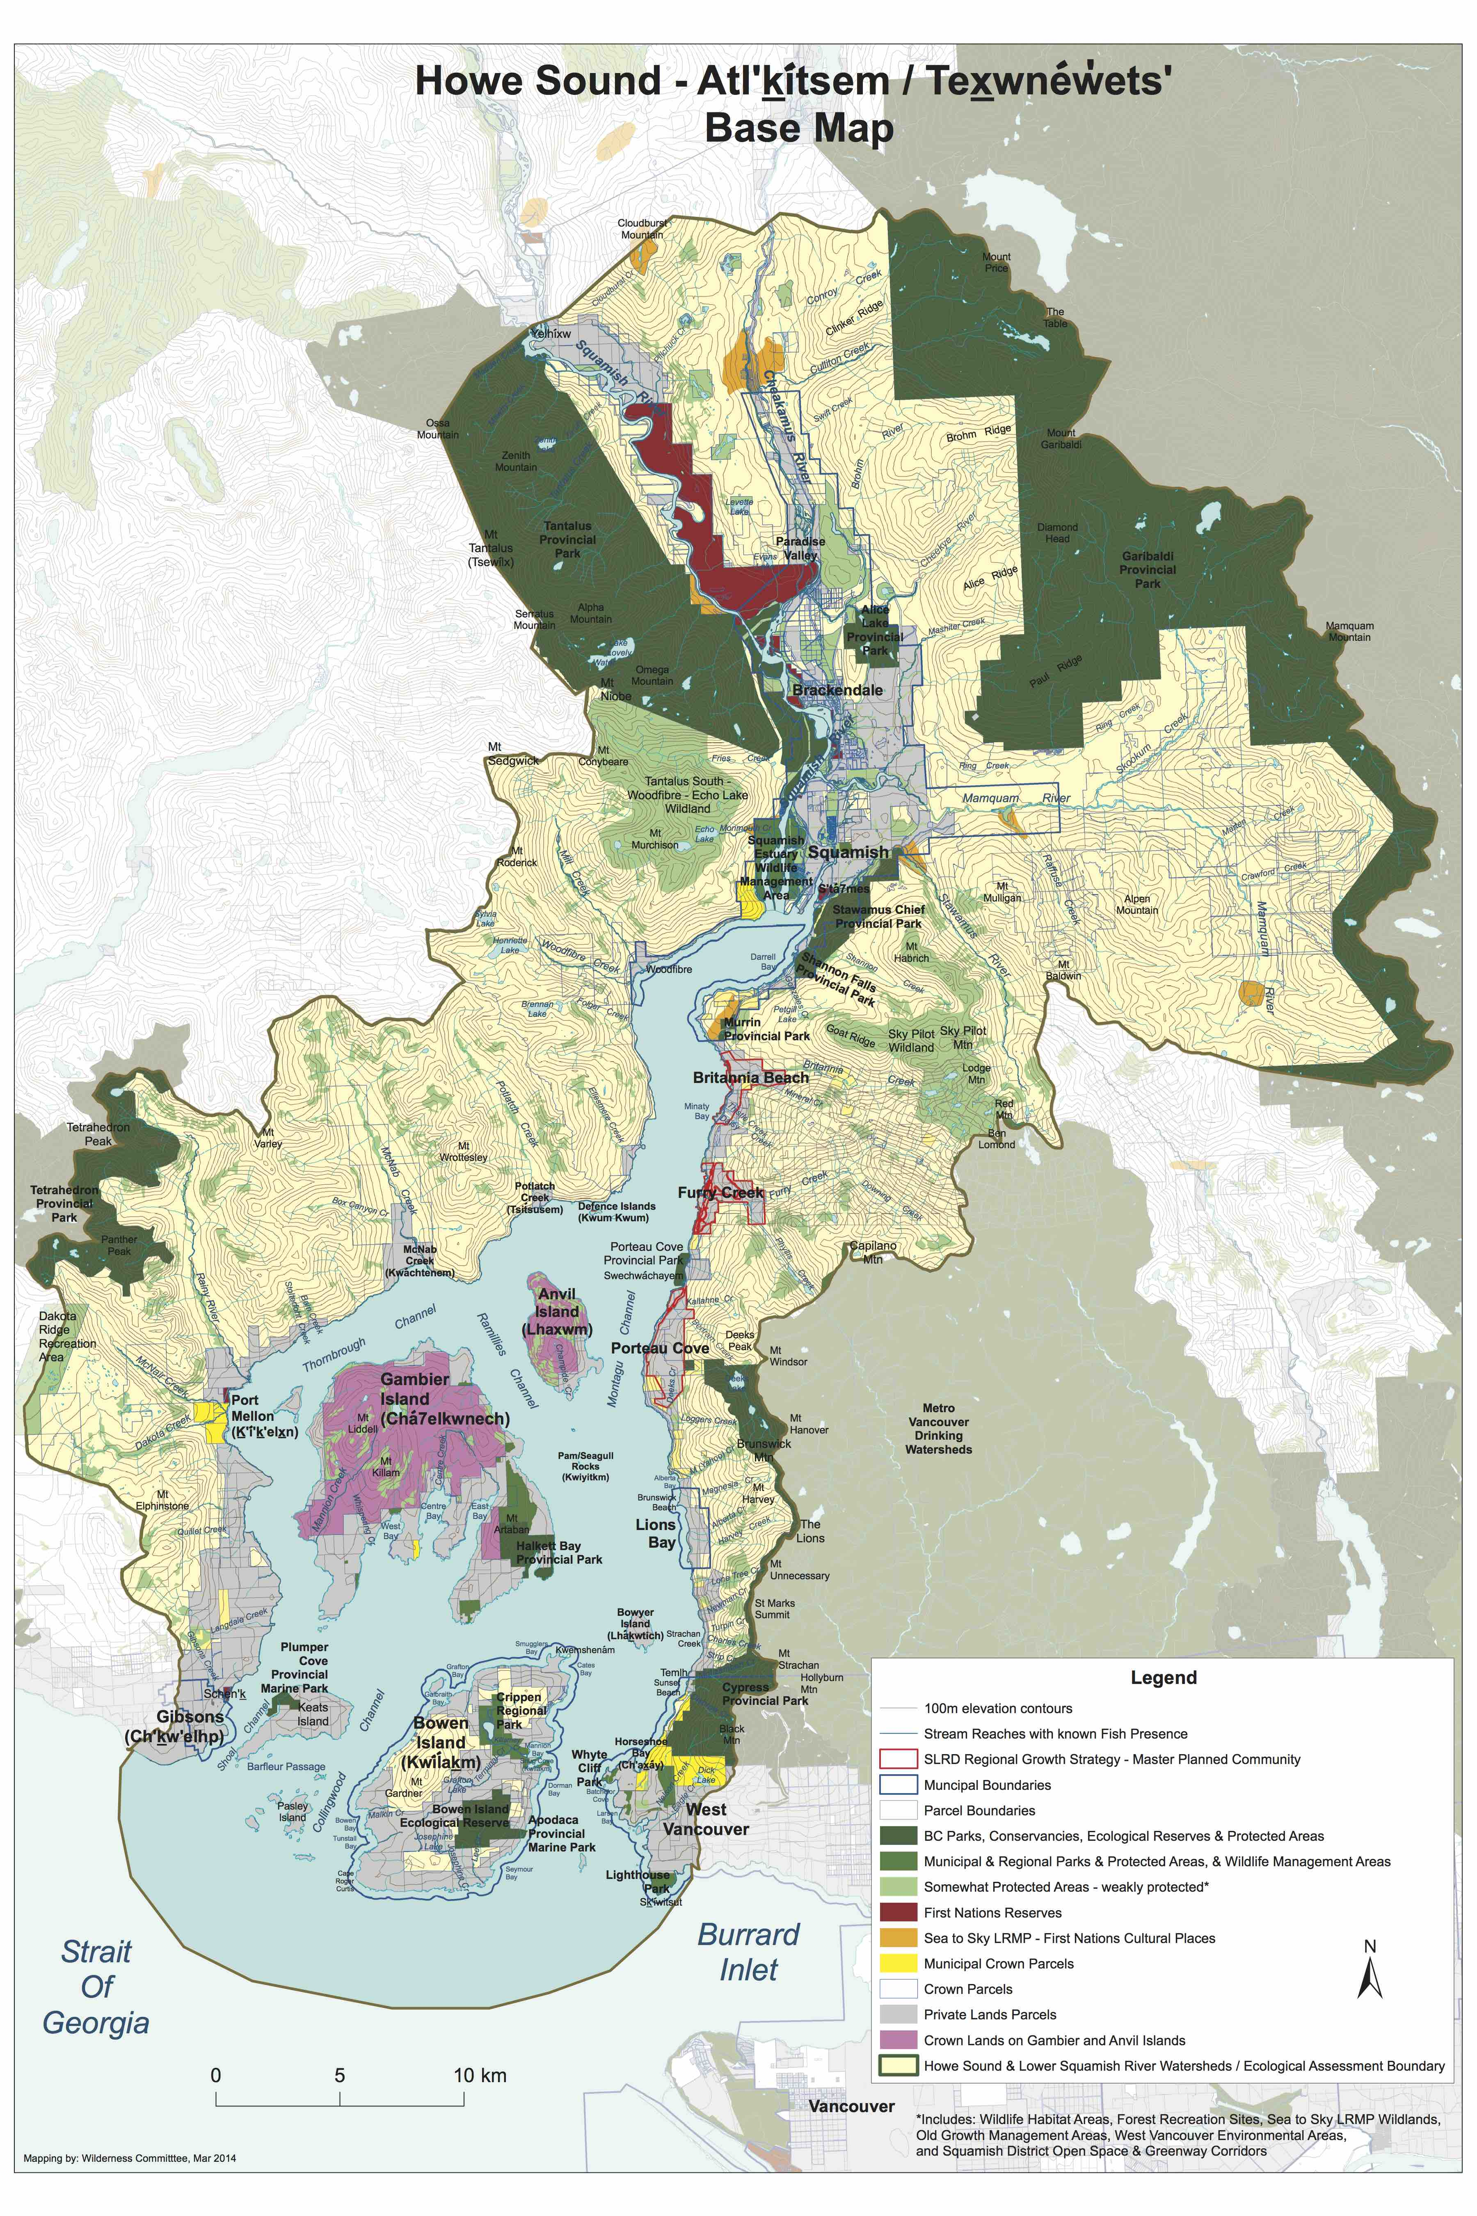
Option #1
“Partial Watershed ” Biosphere
Whistler
Biosphere
Boundary
Squamish
Gibsons
West Vancouver
Map by David Suzuki Foundation
And Western Canada Wilderness Committee

Slide 6
Option #2
“Watershed” Biosphere
Whistler
Biosphere
Boundary
Squamish
Gibsons
West Vancouver

Slide 7
Re-imagining Howe Sound within a
Biosphere Framework
“Core”
“Buffer”
“Zone of Cooperation”

Slide 8
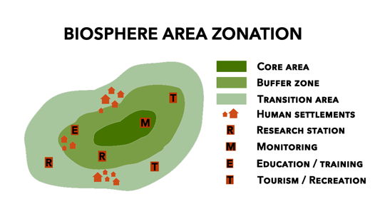
Three inter-related zones
Core: public lands with legal protections.
Reference points on natural state of ecosystems
Buffer: surrounds core. Activities organized to protect core.
Human use less intensive than zone of cooperation.
Transition zone/Zone of cooperation: where people live and work

Slide 9
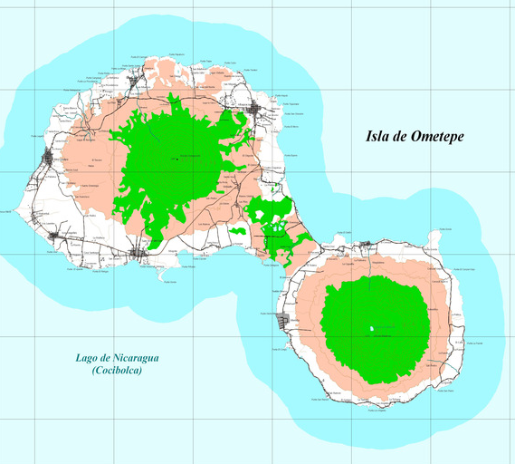
Some Biospheres have
concentric zones
Core
Core
Buffer
Zone of
Cooperation
Zone of
Cooperation
Buffer
Ometepe Biosphere,
Nicaragua
Core
Zone of Cooperation
Buffer
Core

Slide 10
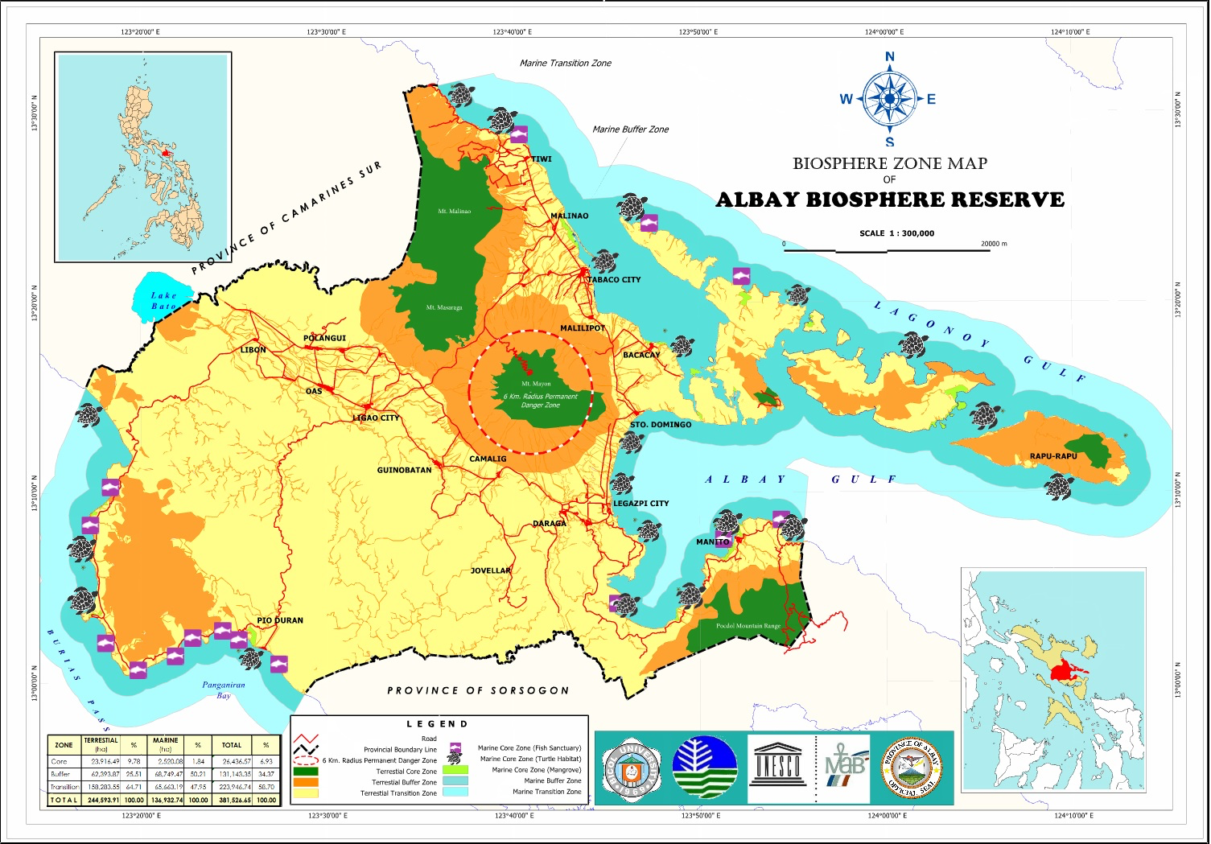
Most Biospheres have
more complicated patterns
Philippines
Marine Buffer area

Slide 11
So what might
Biosphere zoning look like in
Howe Sound?
Howe
Sound
Burrard Inlet

Slide 12
Wa
Watershed Boundary
Biosphere Boundary
Watershed =
Biosphere Area

Slide 13
Whistler
Howe Sound Biosphere
Zone of Cooperation
Squamish
Towns = Zone of Cooperation
FC
LB
HSB
West Vancouver
Gibsons
BI

Slide 14
Howe Sound Biosphere
Zone of Cooperation
Black Tusk
Squamish
Valley
Other developed areas =
Zone of Cooperation
Gambier Island

Slide 15
Howe Sound Biosphere
Zone of Cooperation
Hydropower plant
Hydropower plant
Port of Squamish
Log Sorts
Woodfibre
Hydropower plant
Quarry
Industrial areas =
Zone of Cooperation
Port Mellon
Log Sorts
Bowen Island

Slide 16
Howe Sound Biosphere
Zone of Cooperation
Zone of Cooperation
all private lands

Slide 17
Howe Sound
Biosphere
Core Areas
Skwelwil’em Wildlife
Management Area
Porteau Cove
Nearshore Core areas
Shoreline parks
Island parks/ecological reserves
Plumper Cove
Lighthouse Park
Ecological Reserve

Slide 18
Howe Sound
Biosphere
Core Areas
Porteau Cove
Marine Core areas
Marine protected areas
Rockfish conservation areas
Halkett Bay
Whytecliffe Park

Slide 19
Clendenning Park
Wild
Spirit Place
Howe Sound
Biosphere
Core Areas
Wild
Spirit Place
Garibaldi
Park
Wild
Spirit Place
Wild
Spirit Place
Wild
Spirit Place
Tantalus
Park
Inland Core areas
Inland and alpine parks
Squamish Nation Wild Spirit Places
(Xay Temixw (Sacred Land) Land Use Plan
Tetrahedron
Park
Cypress Park

Slide 20
Howe Sound
Biosphere
Core Areas
Howe Sound
Biosphere
Core Areas
Core areas
All existing
protected areas

Slide 21
Howe Sound
Biosphere
Buffer Areas
Crown
Land
Crown
Land
Crown
Land
Crown
Land
Howe
Sound
Buffer areas
Most Crown Lands
Marine waters ?
Crown
Land
15/10/2016
Burrard Inlet
21

Slide 22
A Biosphere
Framework
for Howe Sound?
Whistler
Squamish
Howe
Sound
Zone of Cooperation
Buffer (Land, Marine)
Core (Land, Marine)
Gibsons
West Vancouver
15/10/2016
Burrard Inlet
22

Slide 23
A Biosphere
Framework
for Howe Sound?
Whistler
Squamish
Howe
Sound
Zone of Cooperation
The
Heartland
Buffer (Land, Marine)
Core (Land, Marine)
Gibsons
West Vancouver
15/10/2016
Burrard Inlet
23

Slide 24
Your Comments and Ideas?
Our Panel
Stan Boychuck, Canadian Man and Biosphere Program
Tom Rafael, Bowen Island
Suzanne Senger, BC Spaces for Nature, Gibsons
Ruth Simons, Future of Howe Sound Society, Lions Bay
Bob Turner, Bowen Island

Slide 25
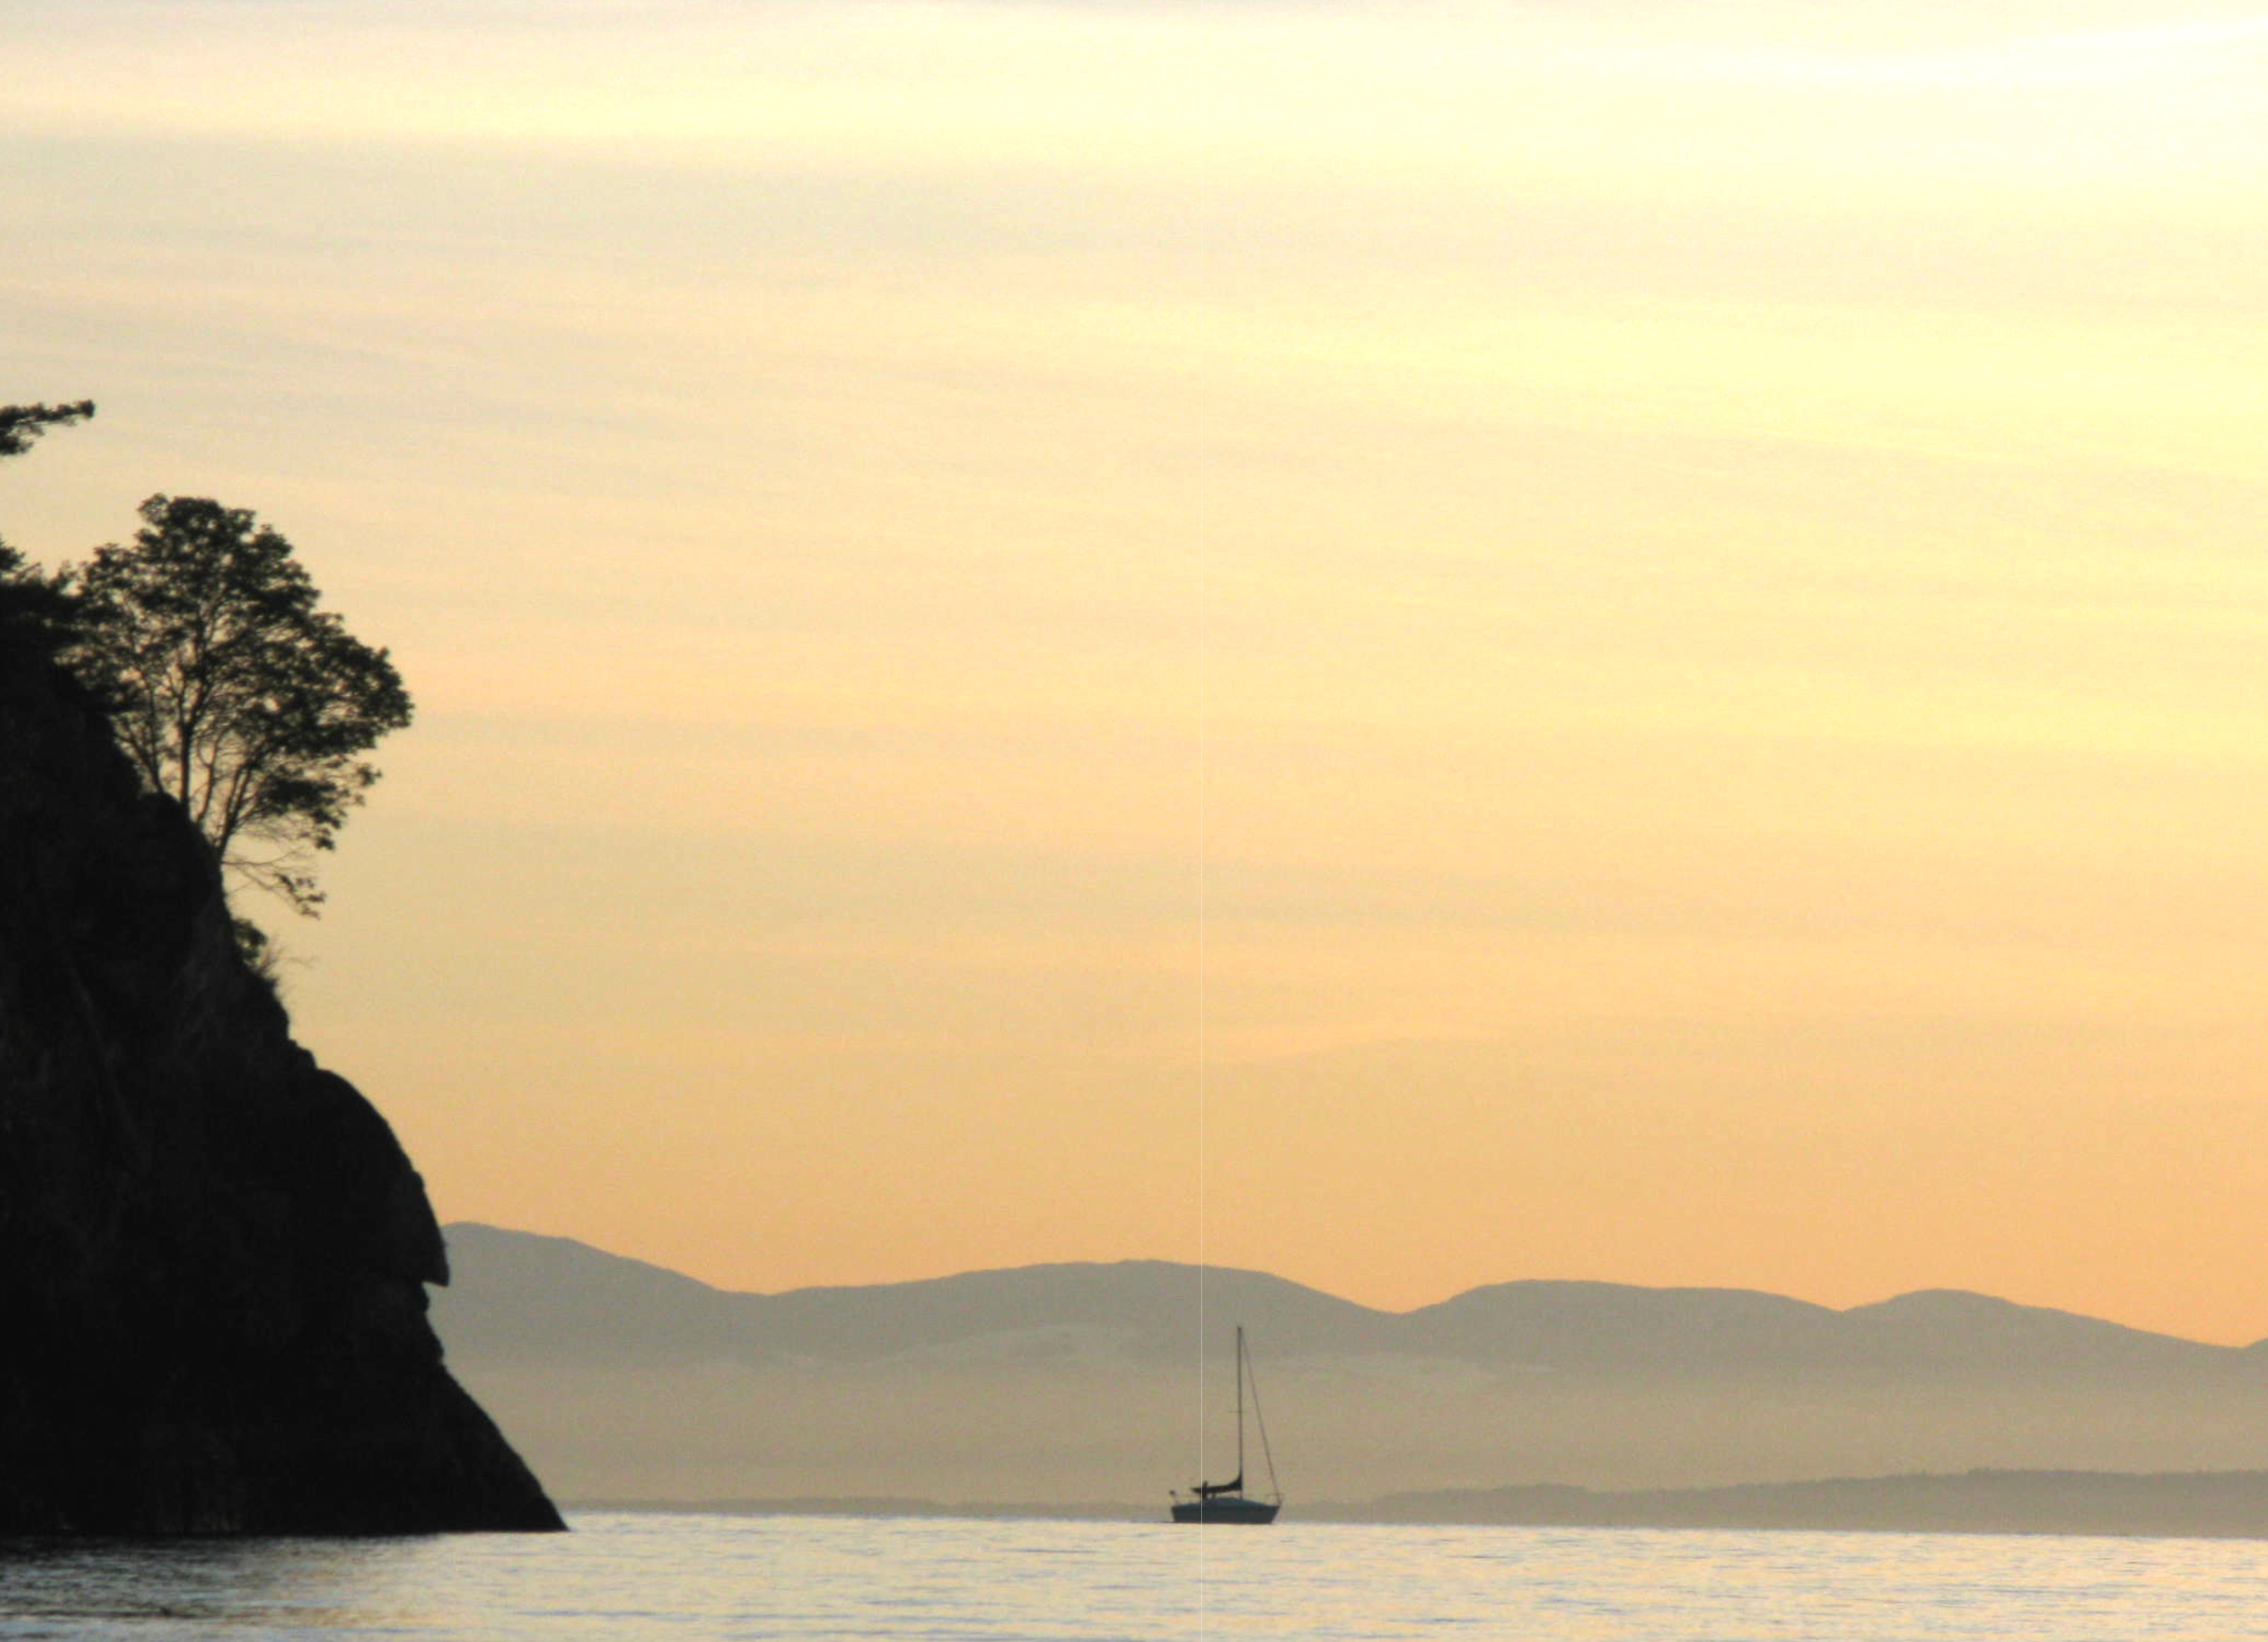
Next Steps
We are seeking support in principle
Local government resolution
Present to councils Fall/Winter
Provide us with Contact person
Interested in joining?
working group?
Advisory role?
By Dec 2016
Move from exploration to nomination
By Sept 2017
submit nomination to UNESCO

